Slide 1
The history of the Countryside Code

Slide 2
What is the
Countryside Code?

Slide 3
What is the Countryside Code?
The Countryside Code offers guidance to both users and custodians of the countryside as to how it can be enjoyed and protected by acting responsibly. It's been with us for over 70 years.
Its wording and presentation has changed over time, but it remains an important tool to help make rural areas in England and Wales safe for visitors to enjoy, without infringing the rights of those for whom the countryside is both home and a place of work.
The Countryside Code now applies to all outdoor spaces including urban parks, the coast and waterways, which are equally important for accessing nature.

Slide 4
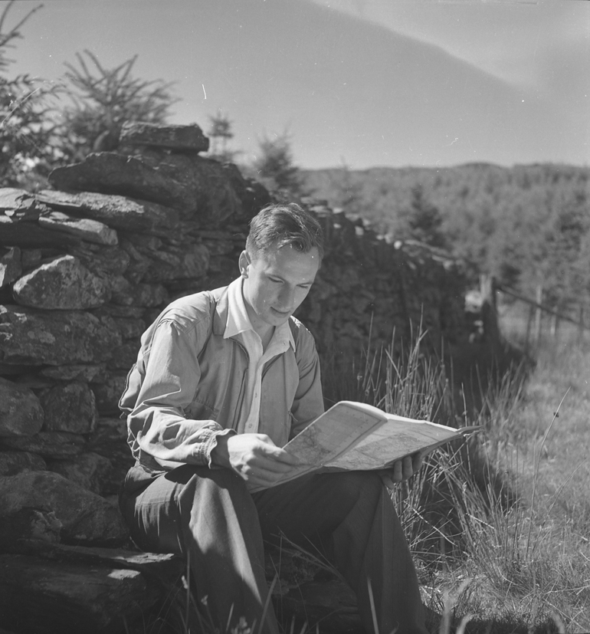
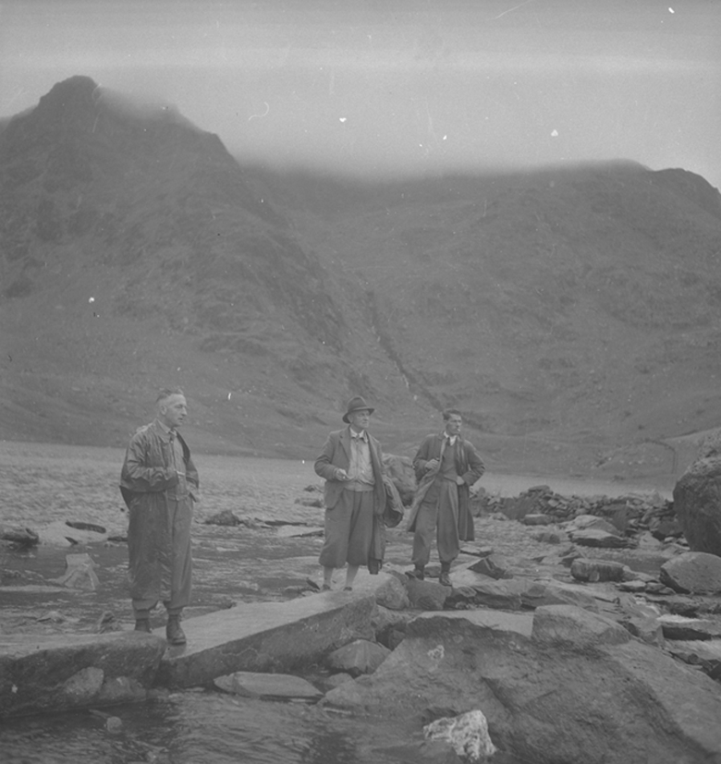
Post World War One – 1918 to 1930
It was the aspiration of the post-war government to create:
“…a land fit for heroes to live in.” (Lloyd George 1918)
Access to the countryside for all was part of this aspiration.
Photos courtesy of Conwy Archive Service.

Slide 5
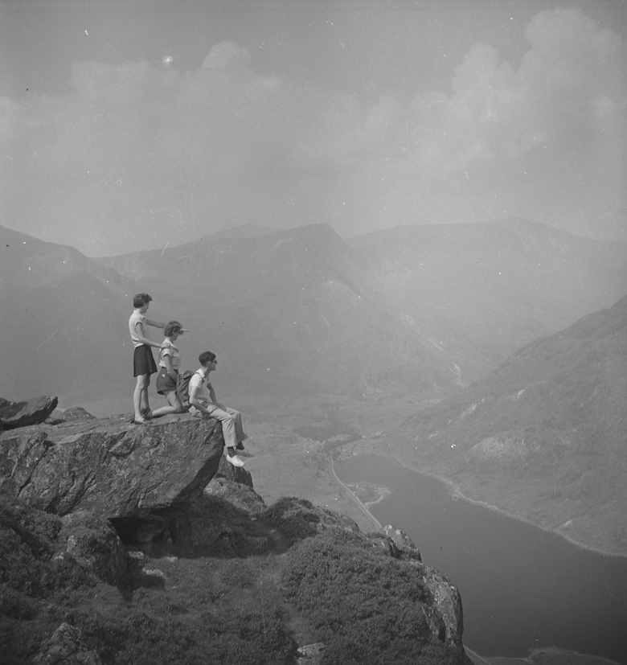
Post World War One – 1918 to 1930
There was a growing appreciation of the outdoors and the health benefits of exercise in the countryside. Workers from industrial towns and cities wanted to walk in the countryside at weekends.
Landowners and those who lived and worked in the countryside were worried that increasing numbers of walkers would cause damage and impact their livelihoods.
Photos courtesy of Conwy Archive Service.

Slide 6
1932: Mass trespass on Kinder Scout
“We ramblers, after a hard week’s work, in smoky towns and cities, go out rambling for relaxation and fresh air. And we find the finest rambling country is closed to us… our request, or demand, for access to all peaks and uncultivated moorland is nothing unreasonable."
Benny Rothman, speaking in his defence at the trial at Derby Assizes.
Photo credit: Working Class Movement Library

Slide 7
Government action began
1932 - Rights of Way Act introduced powers to create Public Rights of Way across private land.
1936 - The Campaign for the Protection of Rural England (CPRE) commissioned a film to be shown in cinemas: ‘Rural England: The Case for the Defence’ *
1945 - Hobhouse report was commissioned, paving the way for National Park legislation.
1949 - The National Parks and Access to the Countryside Act was passed.
“Much of the ill feeling which has existed in the past has been due to ignorance or thoughtless behaviour on the part of some townsmen. This we believe could be considerably reduced by persistent educational efforts. We accordingly recommend that a simple Country Code be prepared and issued. Its object should be to evoke a better all-round standard of responsible behaviour in the countryside and to instill a greater appreciation of the ways and needs of rural life, and the inter-dependence of town and country.”
Extract from the Hobhouse report (Ministry of Town and Country Planning, 1947)
* Please note this film is not available in Welsh.

Slide 8
10 Messages of the 1951 Country Code
Guard against all risk of fire.
Fasten all gates.
Keep dogs under proper control.
Keep to paths across farmland.
Avoid damaging fences, hedges and walls.
Leave no litter.
Safeguard water supplies.
Protect wildlife, wild plants and trees.
Go carefully on country roads.
Respect the life of the countryside.

Slide 9
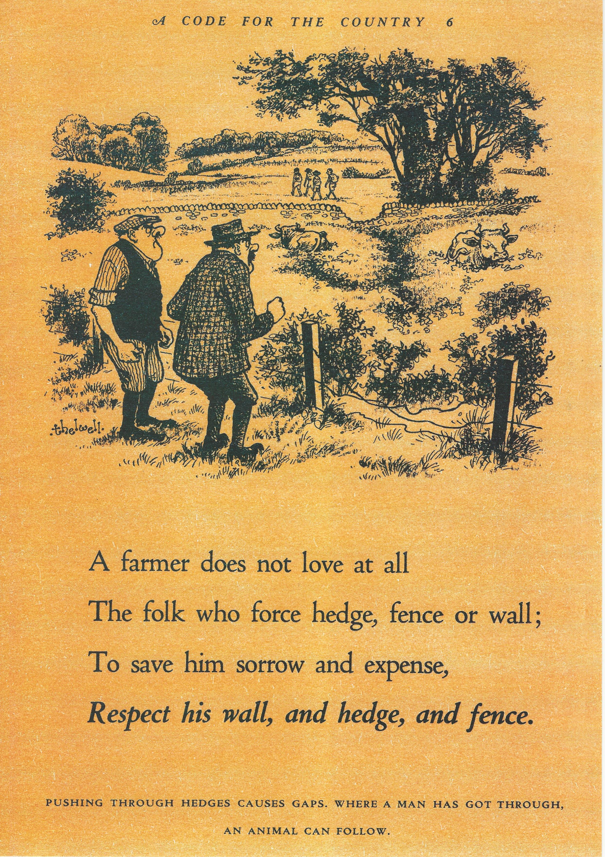
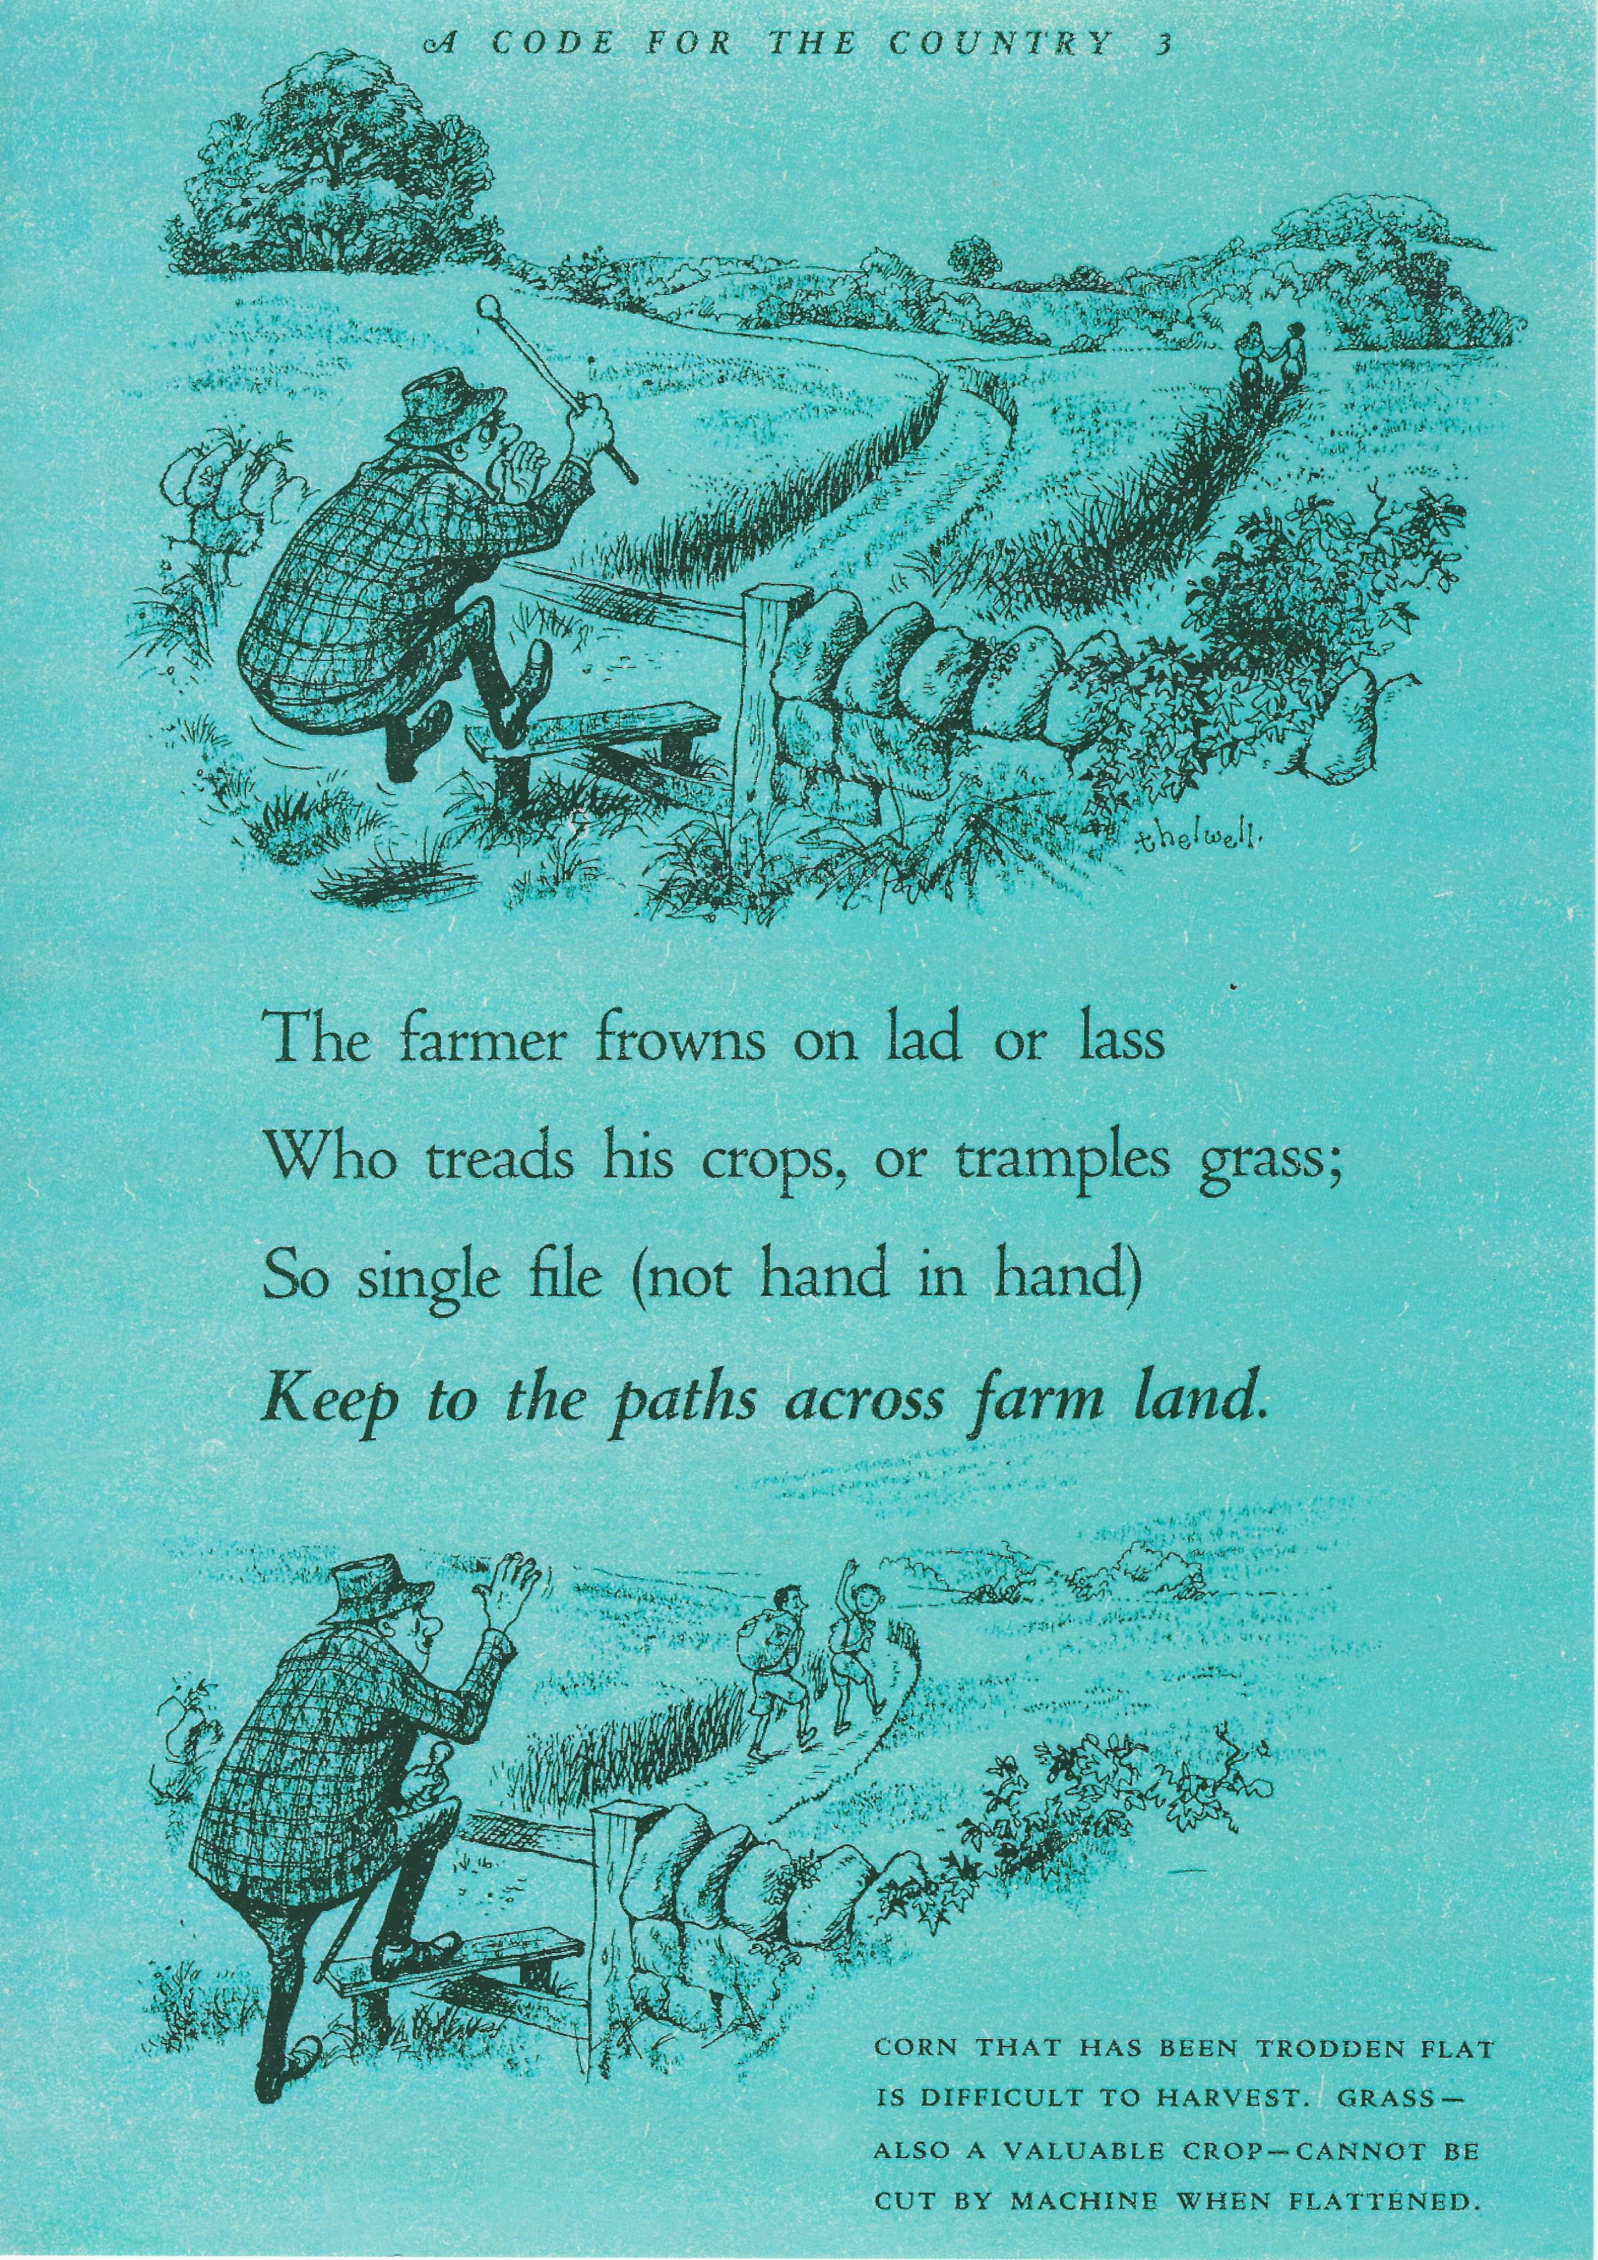
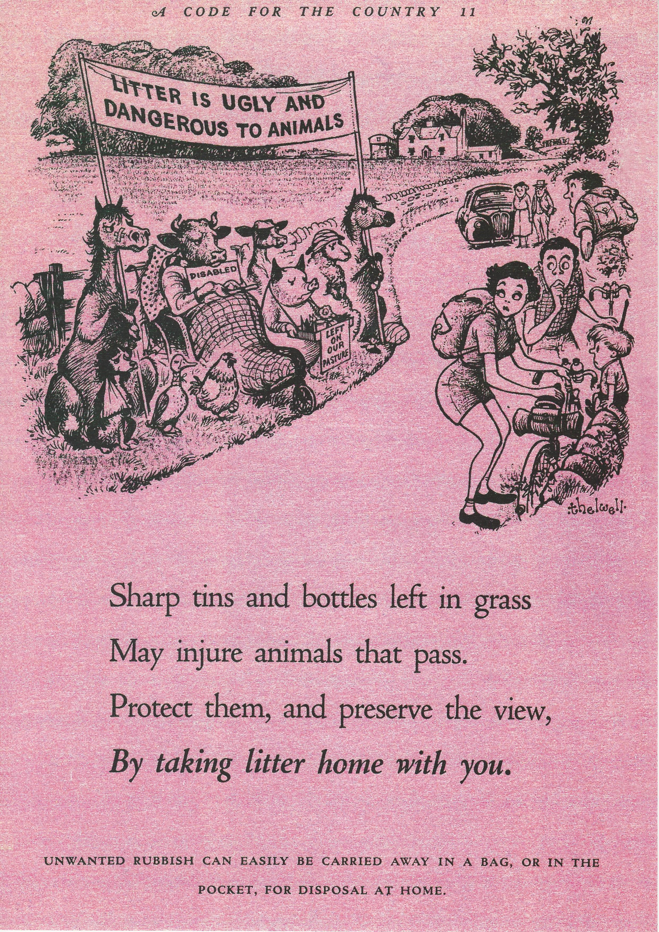
1951: Code promoted with cartoon posters
* Please note these posters are not available in Welsh.

Slide 10
‘When In The Country’ Public Information Film 1963 Country Code Available on YouTube * Length: 4:58 * Please note this film is not available in Welsh.

Slide 11
‘Joe and Petunia’ Public Information Film 1971 Country Code Available on YouTube * Length: 1:02 * Please note this film is not available in Welsh.

Slide 12
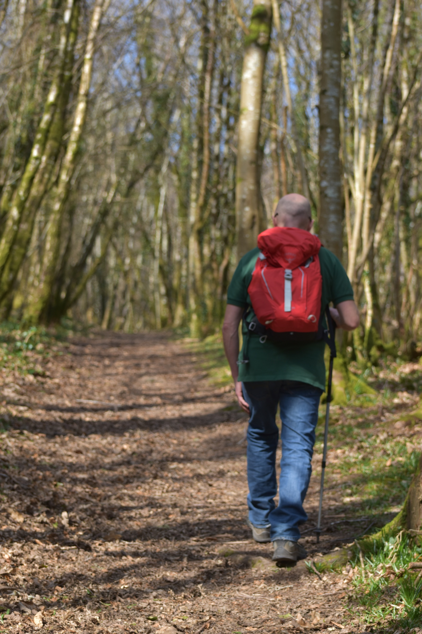
Reorganisation and new legislation
1968: The Countryside Commission for England and Wales was established, replacing the National Parks Commission, and its powers extended to the countryside. The organisation took on the responsibility for the Country Code.
1981: The Wildlife and Countryside Act greatly strengthened provision made in earlier legislation to protect wildlife, providing additional provision for species and countryside protection.

Slide 13
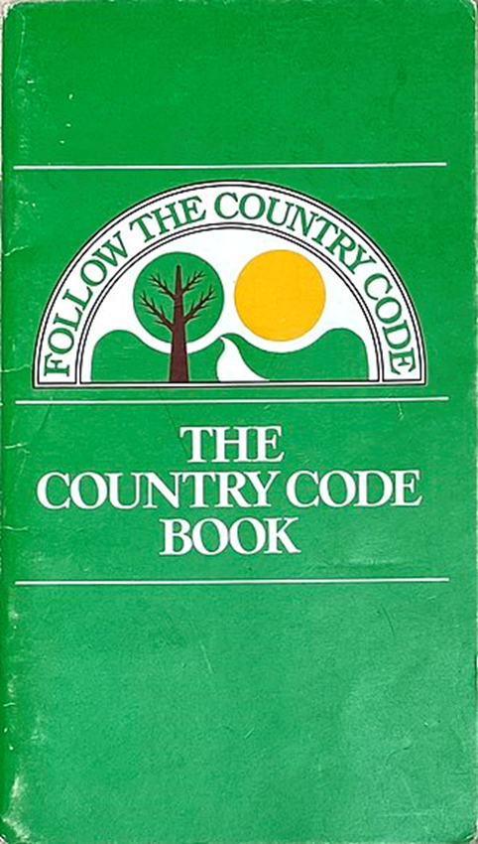
1982: A new 12-point Country Code was launched
1. Enjoy the countryside and respect its life and work.
2. Guard against all risk of fire.
3. Fasten all gates.
4. Keep your dogs under close control.
5. Keep to public paths across farmland.
6. Use gates and stiles to cross fences, hedges
and walls.
7. Leave livestock, crops and machinery alone.
8. Take your litter home.
9. Help to keep all water clean.
10. Protect wildlife, plants and trees.
11. Take special care on country roads.
12. Make no unnecessary noise.
* Please note this book and poster are not available in Welsh.

Slide 14
1990: The Countryside Council for Wales was formed
The Countryside Council for Wales was formed from the Welsh part of the Countryside Commission for England and Wales. The Council took on responsibilities for promoting the conservation of the natural world and the enhancement of natural beauty together with encouraging recreation and enjoyment of the countryside of Wales.

Slide 15
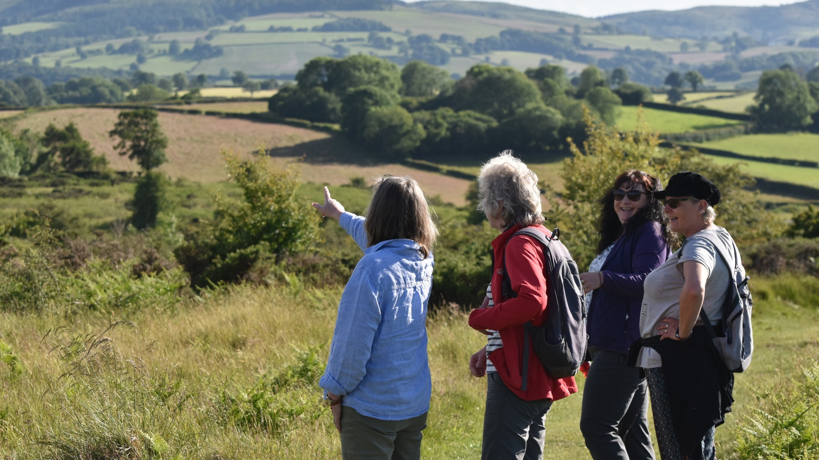
A revised code for the 21st century
2000: The Countryside and Rights of Way Act (CRoW Act) was introduced, giving increased access to open country. This consisted of mountain, moor, heath and downland, and registered common land.
This included a further statutory duty to issue a code of conduct for people using the new right of access.

Slide 16
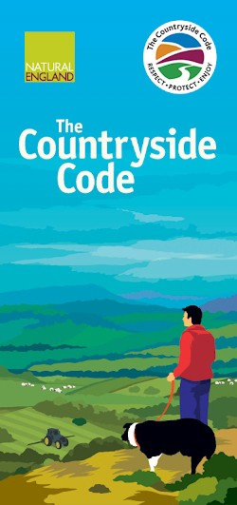
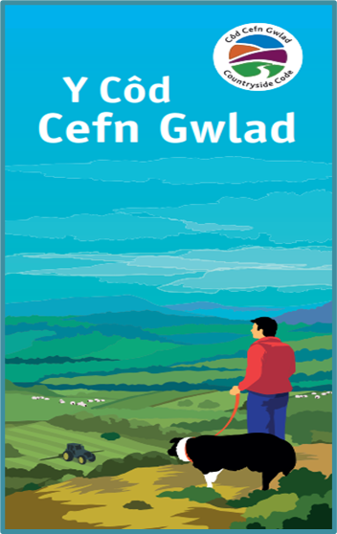
2004: The code was revised and renamed
2004 – The code was revised and renamed ‘The Countryside Code’ and
‘Y Cod Cefn Gwlad’ in Welsh.
English and Welsh versions were produced.
Three key themes were introduced:
Respect - Protect - Enjoy

Slide 17
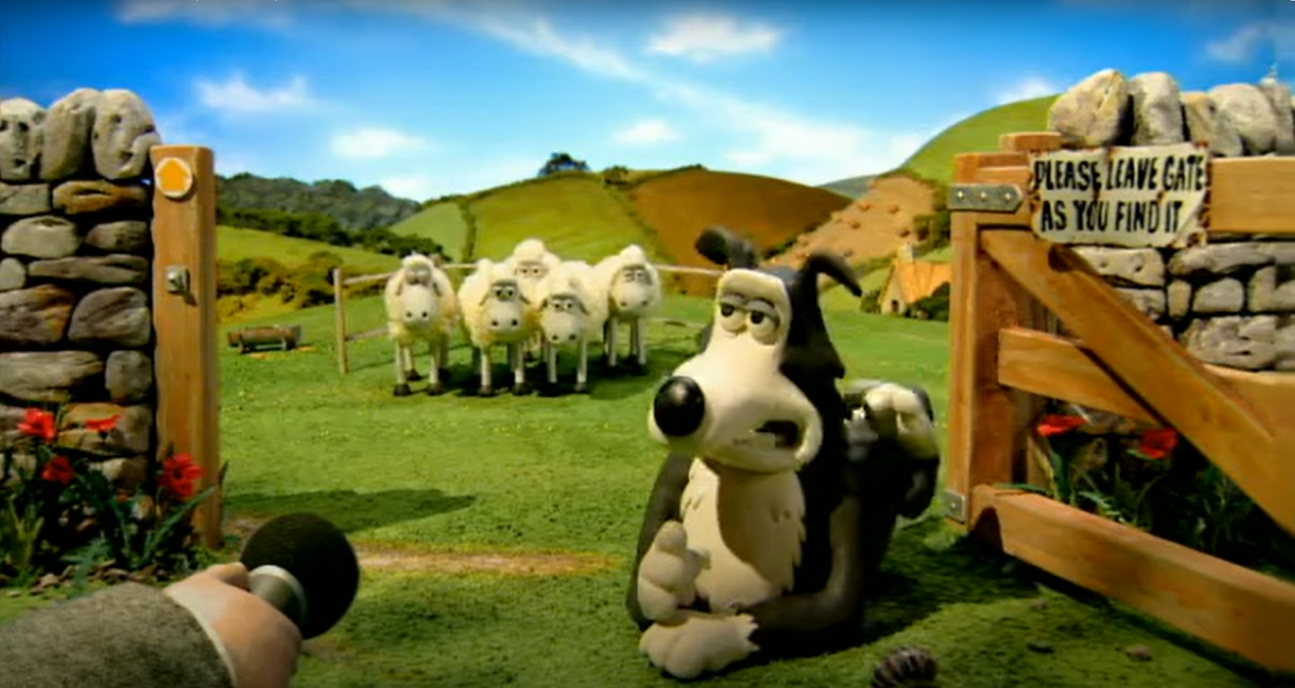
2004: The code was promoted with Aardman cartoon characters
Watch the 2004 Countryside Code film by Aardman on YouTube

Slide 18
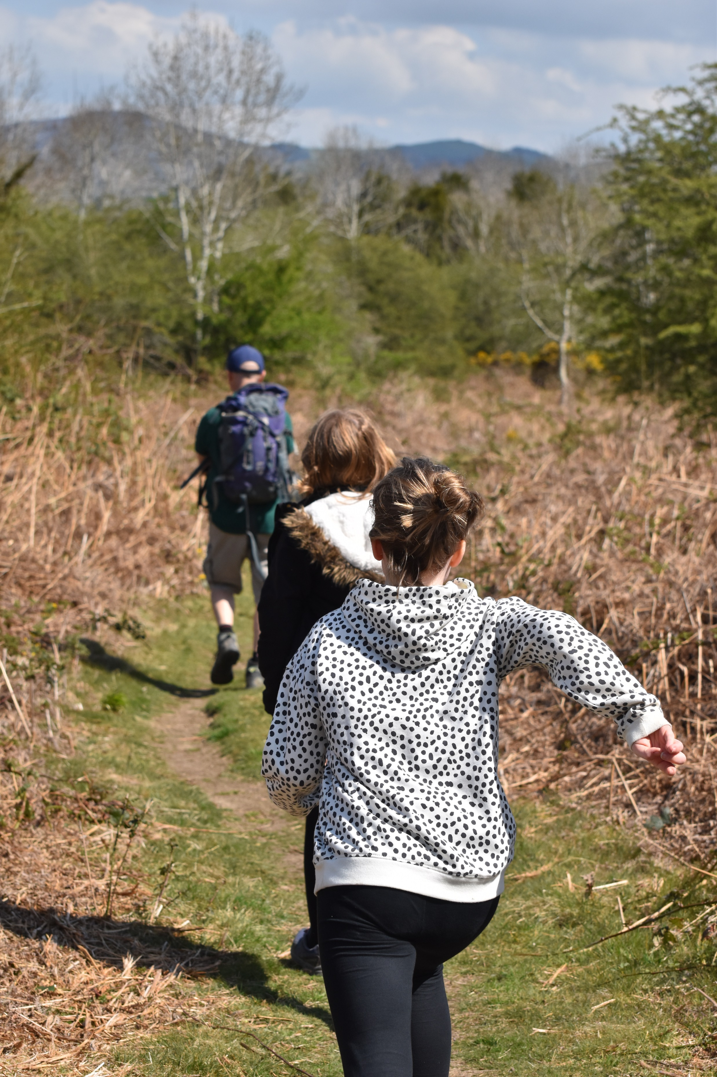
2006: Natural England was formed
In 2006, Natural England was formed and took the place of the Countryside Commission in England.
Both the Countryside Council for Wales and Natural England took over the management of the Countryside Code in their respective countries.

Slide 19
A family of Codes
2010: The Countryside Council for Wales started to develop codes for specific activities and audiences. The Dog Walking Code and the Trail Users Code were introduced.
2013: Natural Resources Wales (NRW) was formed, replacing the Countryside Council for Wales, Forestry Commission Wales and Environment Agency Wales. NRW expanded the family of codes with the Wild Swimming Code, the Angling Code, the Canoeing Code and the Waterside Code.

Slide 20
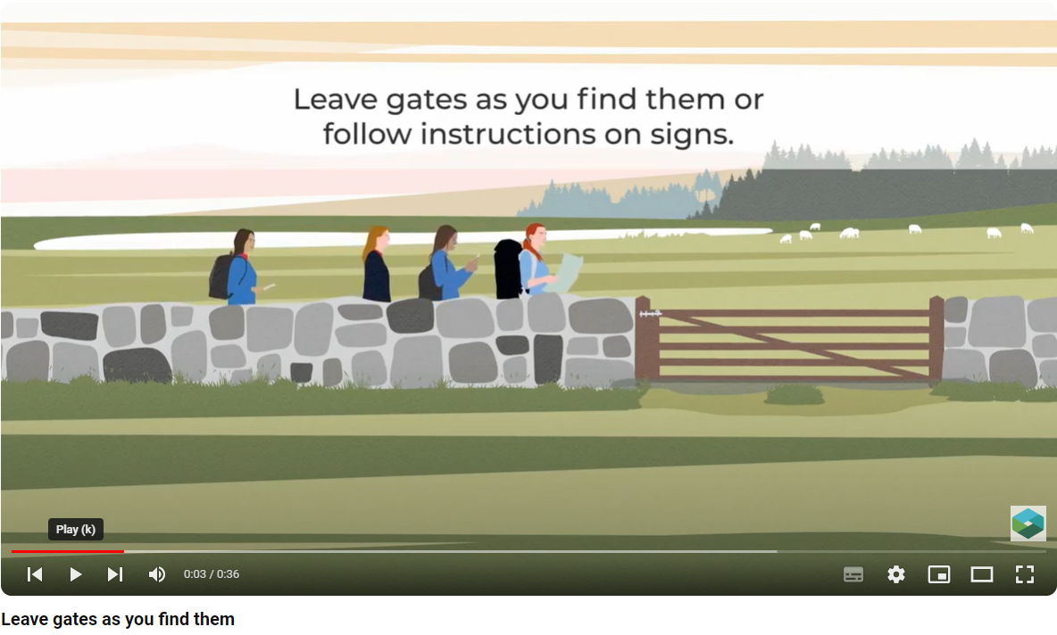
A family of Codes
2019: NRW launched a suite of bilingual animations to promote the codes online.
Available on YouTube *
Length: Various

Slide 21
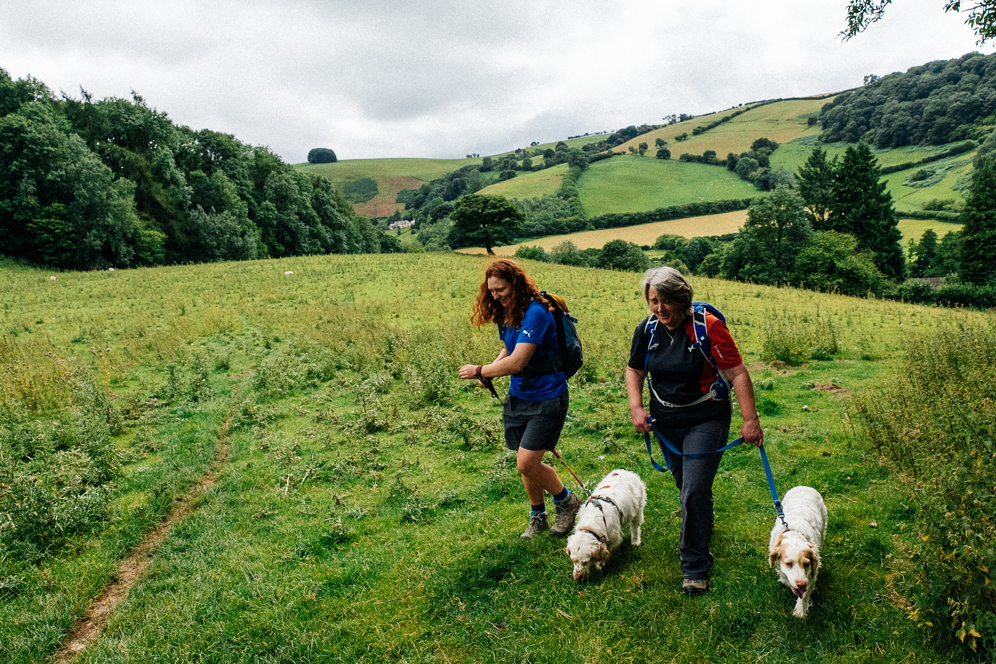
2021: The Countryside Code was re-launched to mark its 70th anniversary
The code focused on three themes:
Respect everyone
Protect the environment
Enjoy the outdoors
It had a refreshed tone of voice, creating a guide for the public rather than a list of rules, and recognised the significant health and well-being benefits of spending time in nature.
A short film was also created to mark the 70-year history of the code and restate its importance.

Slide 22
2022: Land Manager’s Code launched
A new code was developed to give advice to land managers.
It explained their rights and responsibilities so they could help visitors follow the Countryside Code.

Slide 23
2023: Shaun the Sheep became a Countryside Code champion
Watch Shaun’s Countryside Code adventures on YouTube

Slide 24
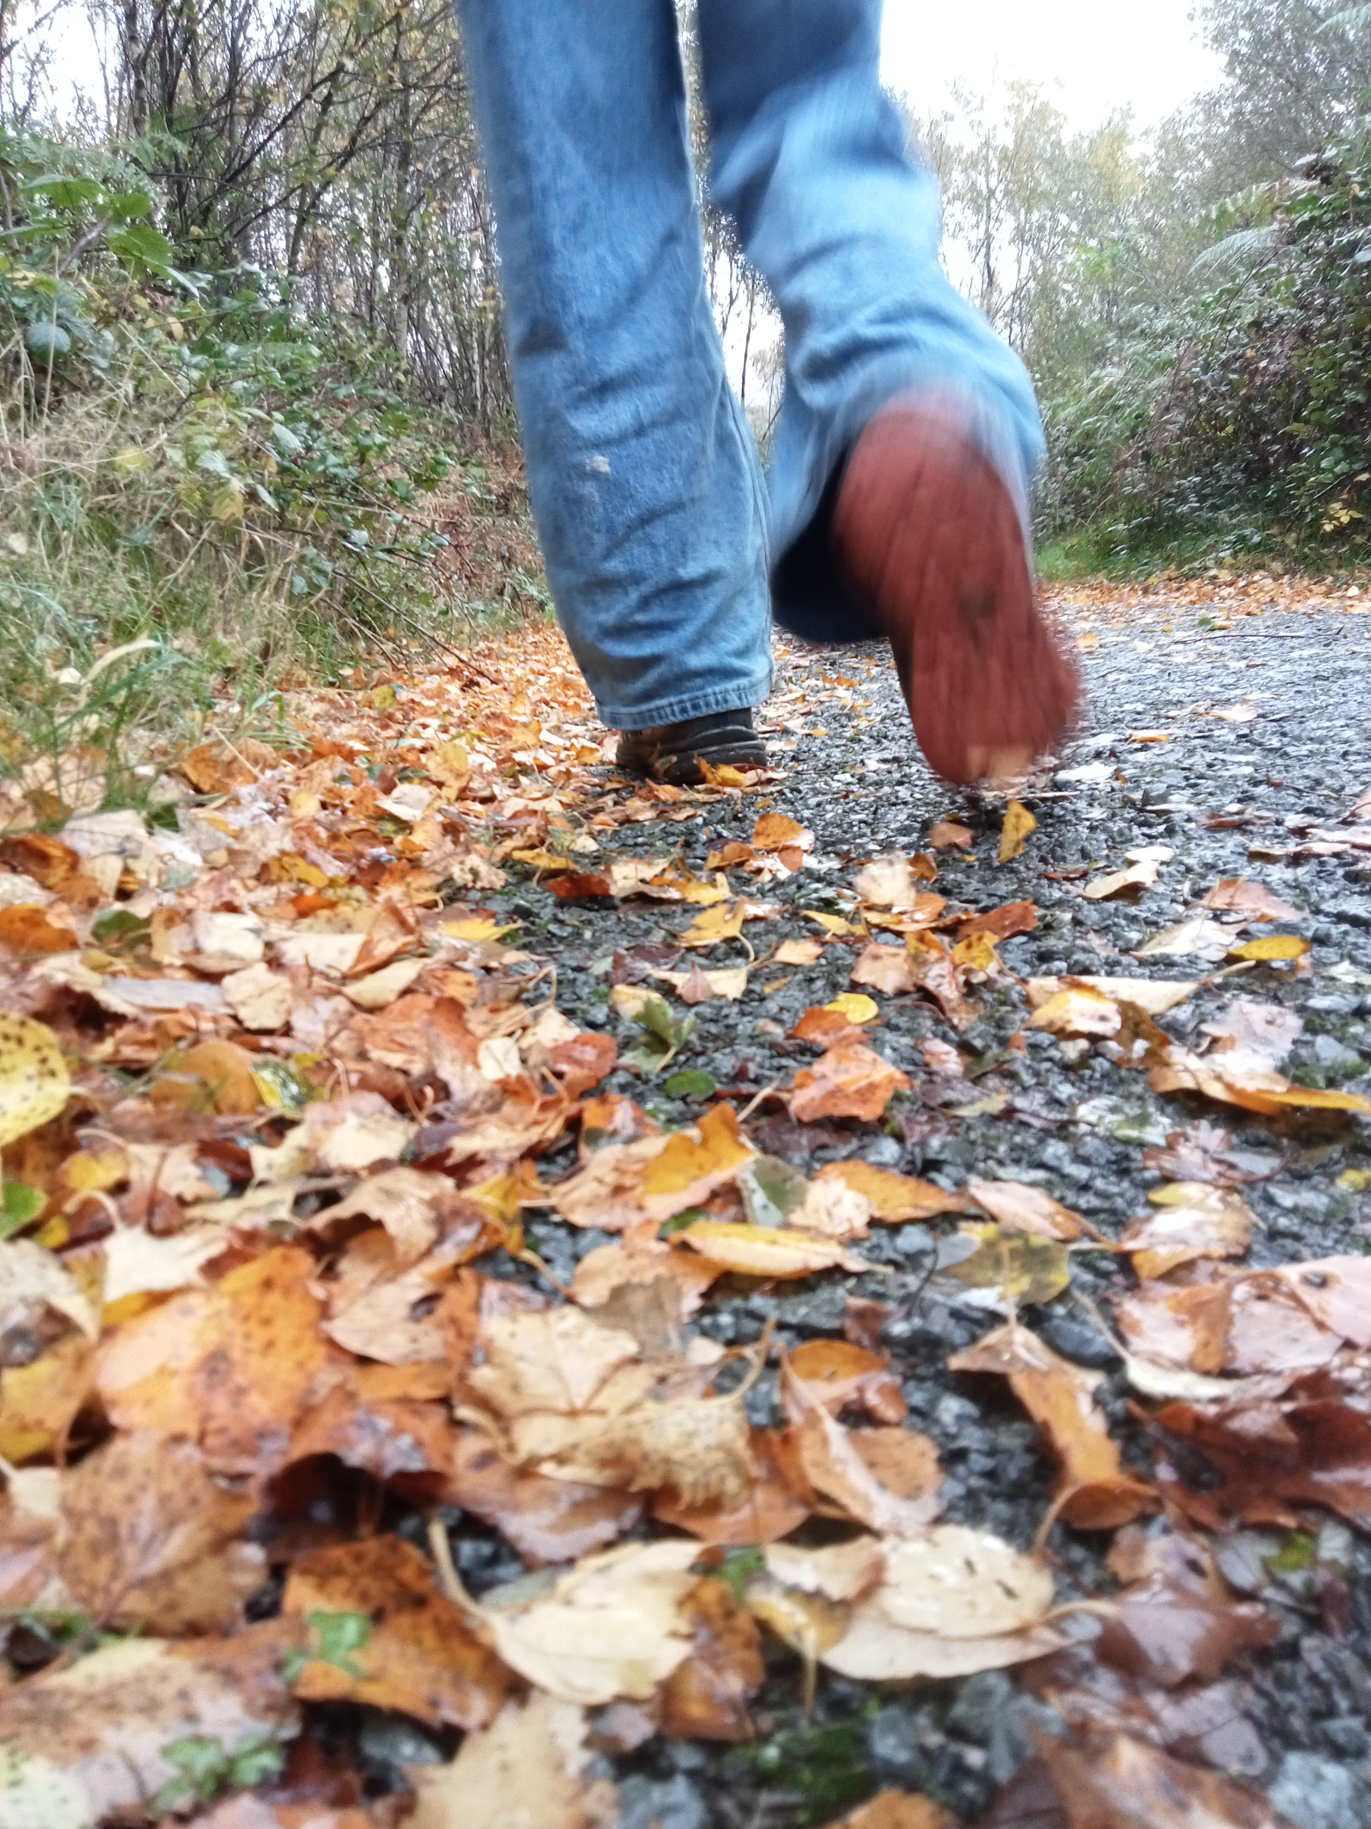
The future…
The Countryside Code will continue to help us respect everyone, protect the environment and enjoy the outdoors. Importantly, it remains a guide advising us all about enjoying our visits to parks and waterways, coast and countryside whilst respecting those that live and work in those places.
What do you think it will look like in 100 years' time?

Slide 25
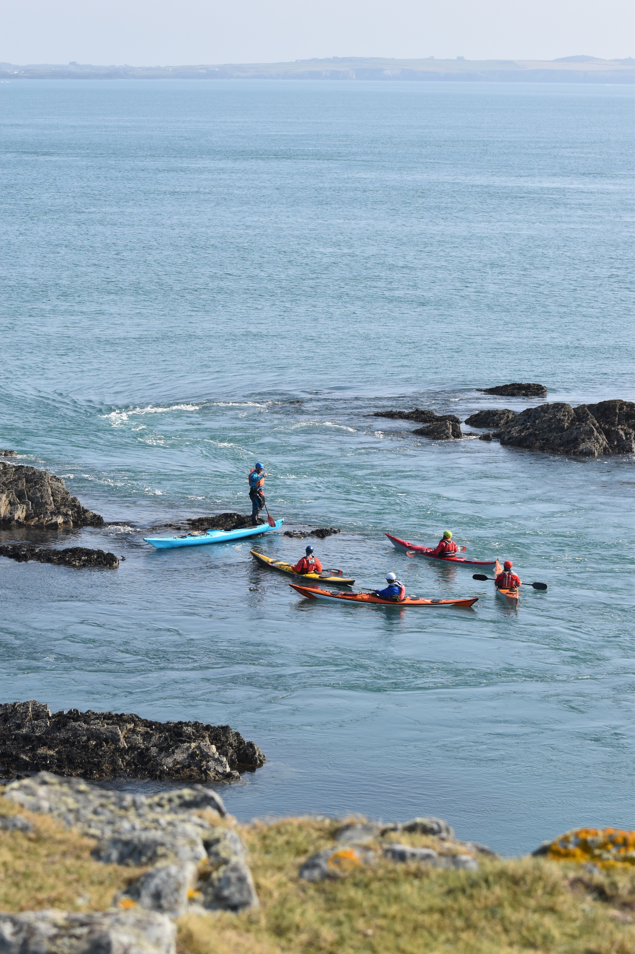
Additional Resources
Websites
Learning about the Countryside Code
The Countryside Code Family - NRW website
The Countryside Code campaign website
Leaflets and posters
Summary leaflet / Summary poster
Waymarker symbols poster
Toolkit
Images, videos and information for people to download and use in their communications:
Countryside Code toolkit (Wales)
Videos
YouTube playlist

