Slide 1
Step it up – Marketing the Wales Coast Path: Writing a promotional website

Slide 2
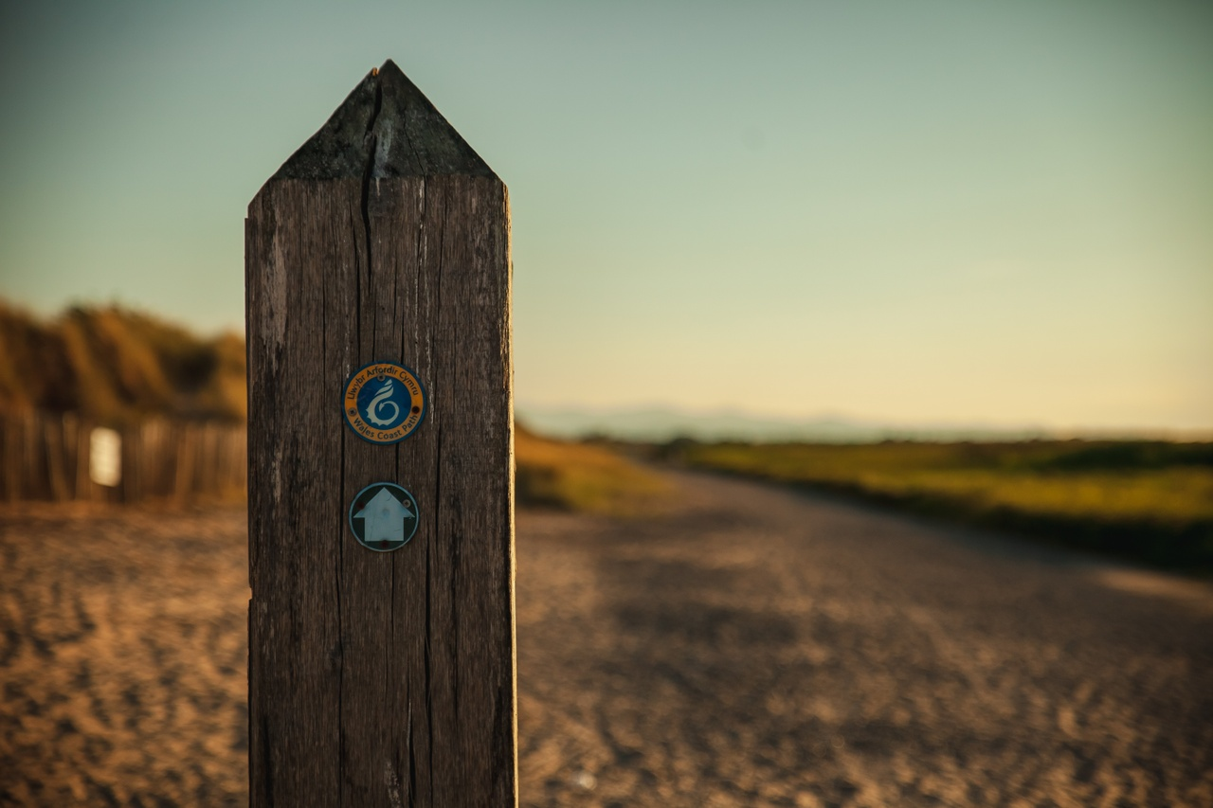
Background - What is the Wales Coast Path?
An 870-mile-long continuous coastal footpath which stretches along the entire length of the Welsh coastline.
The whole path is accessible to walkers, with some sections suitable for cyclists, families with pushchairs, people with restricted mobility, and horse riders.

Slide 3
What is marketing?
Working in small groups, discuss and write down:
• What to do you understand by the term ‘marketing’?
• What does marketing do?
• Why do people use marketing?
• Who uses marketing? Can you think of any companies or organisations that market their products?
• When do things get marketed?
• What are the pros and cons of marketing for an organisation?

Slide 4
What is marketing?
Marketing is about making sure the right people know about what you have to offer, getting them to come to you and getting them to buy or buy into what you have to offer.

Slide 5
Your brief
Imagine you are marketing experts.
Your client Natural Resources Wales (NRW),
would like your help to plan and create a promotional website for the Wales Coast Path.
Your website could be accessed by people all over the world that want to plan to visit the Wales Coast Path.

Slide 6
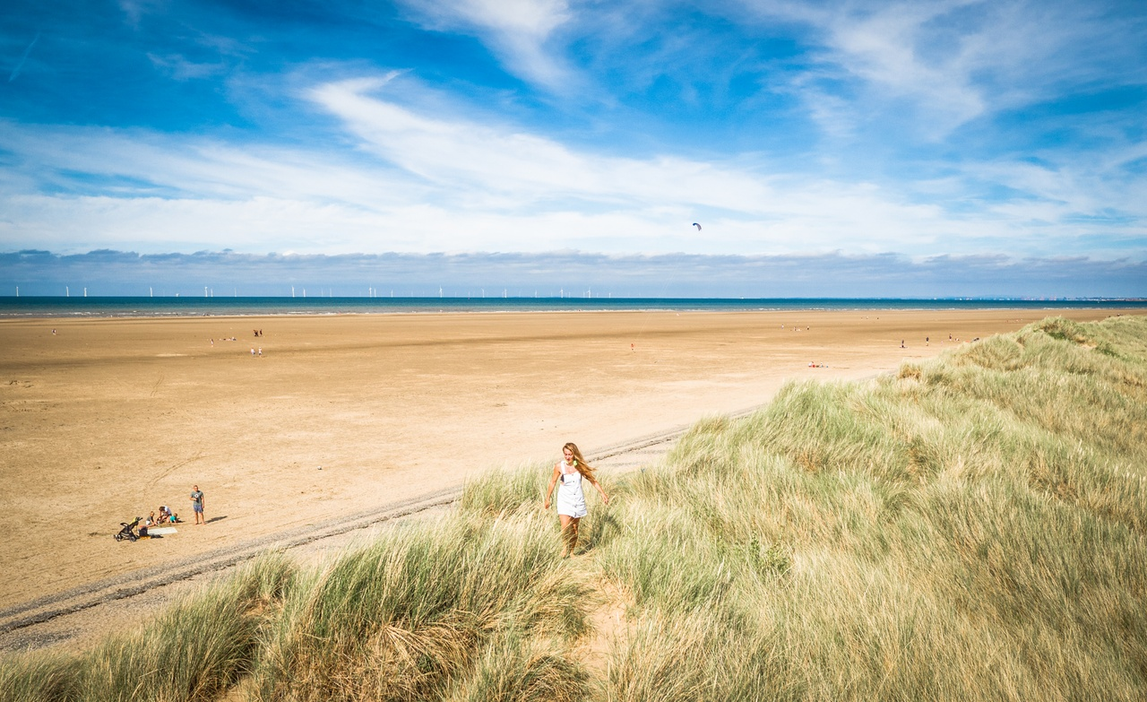
Task
Working in small groups:
Consider, is there a section of the path your group would like to promote?
Or will you create a website to promote the Wales Coast Path in general?

Slide 7
Discuss: What are the pros and cons of a promotional website?

Slide 8
Background information
What do you know about the client?
Understanding your client’s business is critical to ensuring the success of your marketing campaign.
What does your group know about Natural Resources Wales?
What does the organisation do?
How many staff does the organisation employ?
What are its roles and responsibilities?
What is its role in the Wales Coast path?
Click the icon to watch a short video about what NRW does

Slide 9
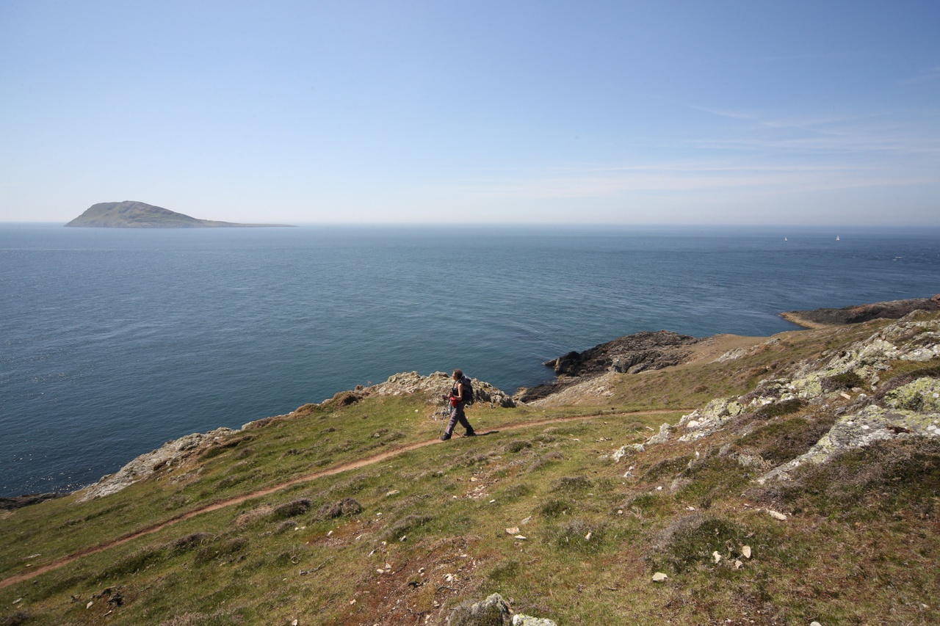
What do you know about the Wales Coast Path?
Complete some research into the history and significance of your chosen section of the Wales Coast Path.

Slide 10
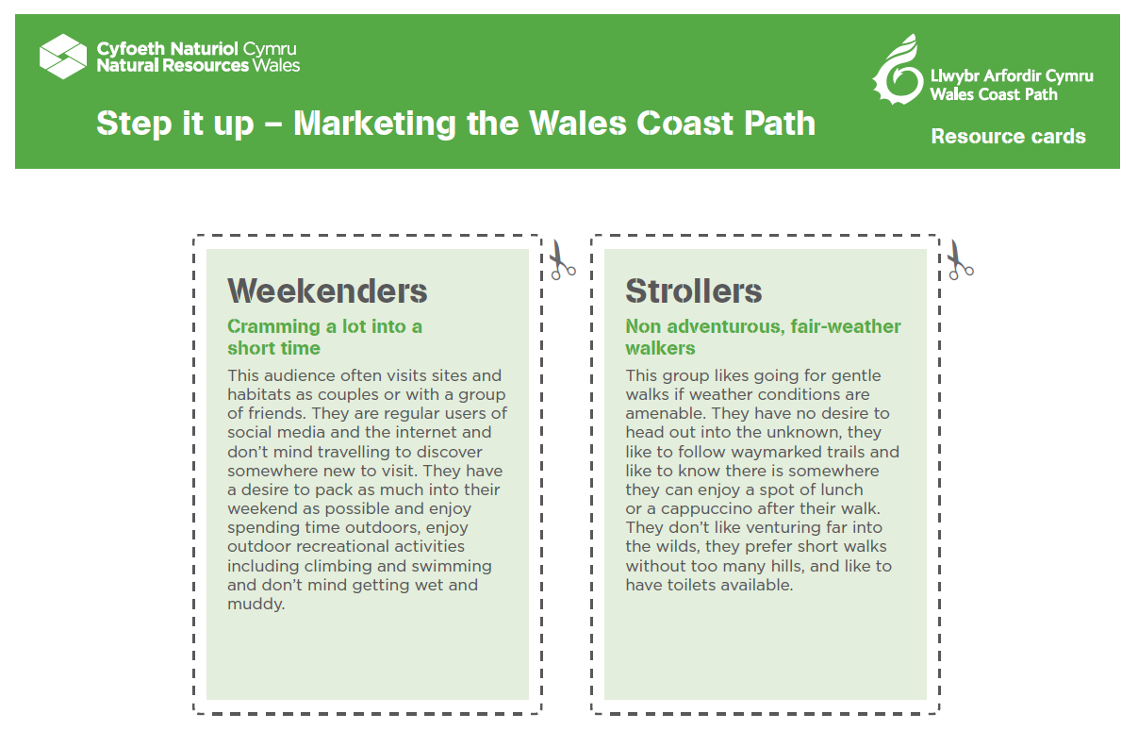
Identify who’s the target audience?
A target audience is the specific group of people you want to reach with your marketing materials. They are the people who are most likely to be interested in your content.

Slide 11
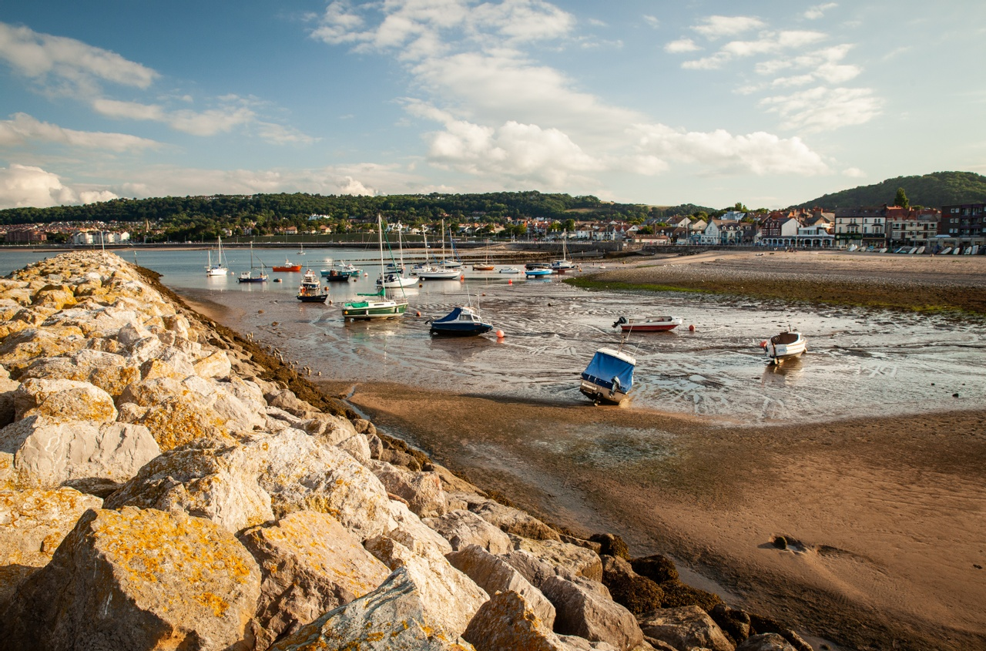
If you are visiting the Wales Coast Path…
…there may be opportunities to carry out some market research and on-site investigations
What are your first impressions of the Wales Coast Path? Note your observations.
Can you create a word cloud to capture the unique selling points of the Path?
Can you prepare a questionnaire to get insights into why people visit the Path?

Slide 12
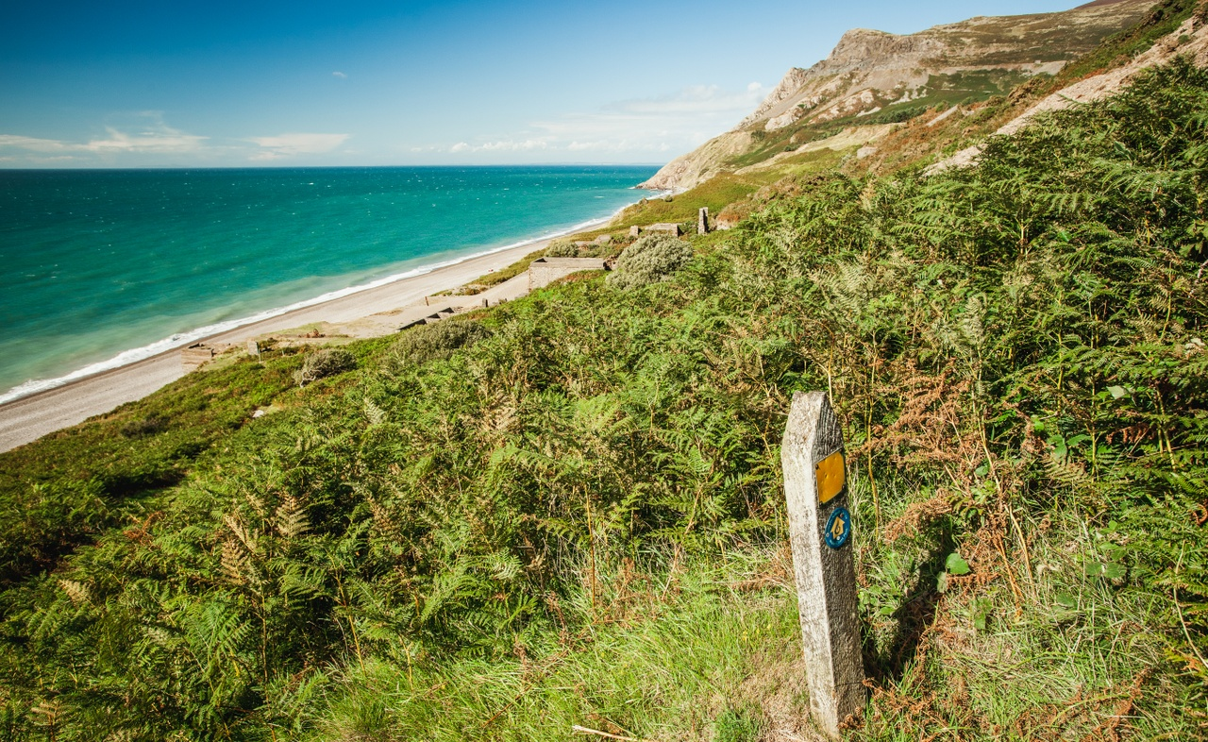
If you are visiting the Wales Coast Path…
…there may be opportunities to carry out some market research and on-site investigations
Create a simple data collection sheet to record the number of users visiting the given stretch of path.
Take photos – these might feature on your website!

Slide 13
Planning and sharing ideas for your promotional website
What are the unique selling points of your chosen section of the Wales Coast Path?
People who work in the marketing industry talk about the Unique Selling Point (USP) – the thing which makes their offer different and/or better than others.
What are the unique selling points of the Wales Coast Path that you want to promote to your target audience? Note your ideas.
How will you communicate them?

Slide 14
Sharing your initial ideas with the client
Get feedback and approval from the client before pressing ahead with your ideas.
You could pitch your ideas to the ‘client’ in the form of a:
• Group presentation – using Microsoft PowerPoint or Google Slides.
• Two-minute group talk – explaining your main ideas and thoughts on the direction the promotional website should take.
• Create a mood board - A mood board is a digital or physical, pictorial collage of ideas.

Slide 15
Set SMART objectives for the creation of your promotional website
Make sure your objectives are:
S – Specific
M – Measurable
A – Achievable
R – Relevant
T – Time bound

Slide 16
Set SMART objectives for the creation of your promotional website
Make sure your objectives are:
S – Specific e.g. We want to create a promotional website to raise awareness of the wildlife along the Wales Coast Path.
M – Measurable e.g. we want to increase the number of visitors to the Wales Coast Path by 5%.
A – Achievable There’s no point trying to increase the number of visitors to the Wales Coast Path by 2 million people if you only have 3 weeks to achieve this. Although it’s a great aim, it would be very hard to achieve.

Slide 17
Set SMART objectives for the creation of your promotional website
Make sure your objectives are:
R – Relevant The whole purpose of your promotional website is to increase awareness and use of the Wales Coast Path. If your plan ends up raising awareness of a new garage that has opened in the area, then it’s not relevant!
T – Time bound Is what you plan to write about on your website feasible in the time you have available? Set deadlines to complete tasks by, this will help you prioritise and reduce the risk of you becoming overwhelmed.

Slide 18
Risks/Challenges
Planning and creating a promotional website may not appear to involve much risk, but thinking about risk is integral to communication.
Consider:
What could go wrong when you upload your promotional website?
2. What is the likelihood and impact of something going wrong?
3. What can you do to minimise the risk?

Slide 19
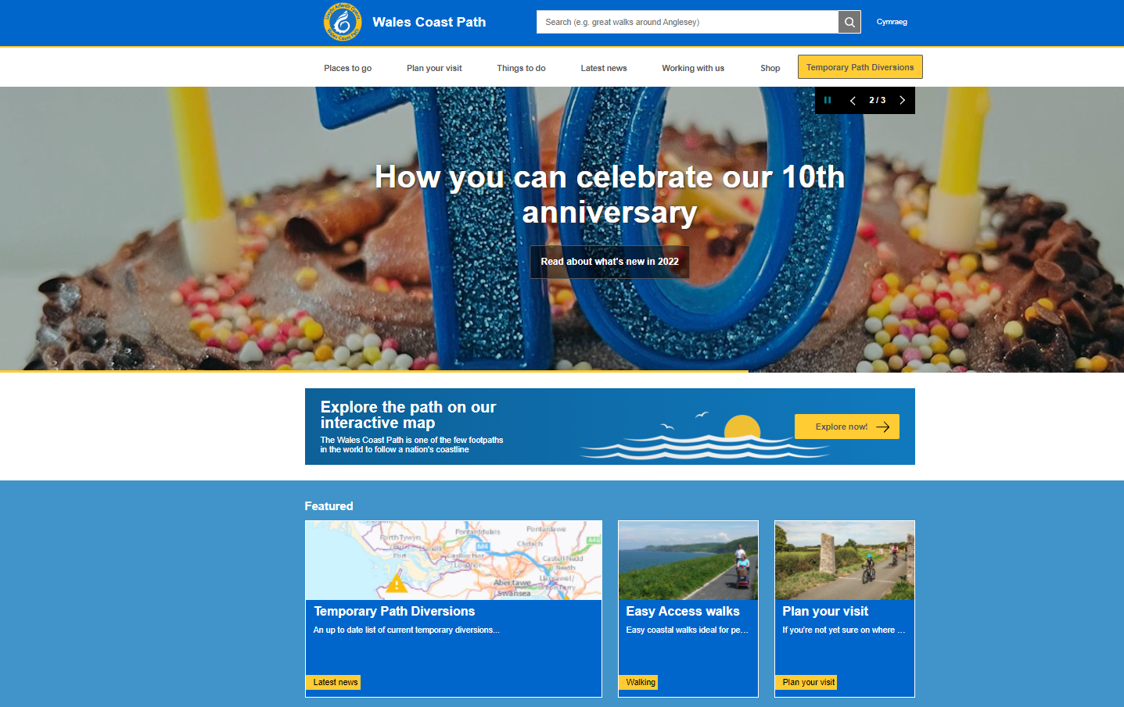
Creating your Wales Coast Path promotional website
Websites:
Easy way to keep in touch with loyal or prospective Wales Coast Path visitors.
Don’t need to cost a lot.
Easy to access information, plan their visit, and answer potential questions visitors may have.

Slide 20
Create a simple template for your website

Slide 21
What lessons can you learn?
As a group, look at a range of promotional websites and scrutinise them.
What are the pros and cons of each website?
What lessons learnt can you carry over to your own website?

Slide 22
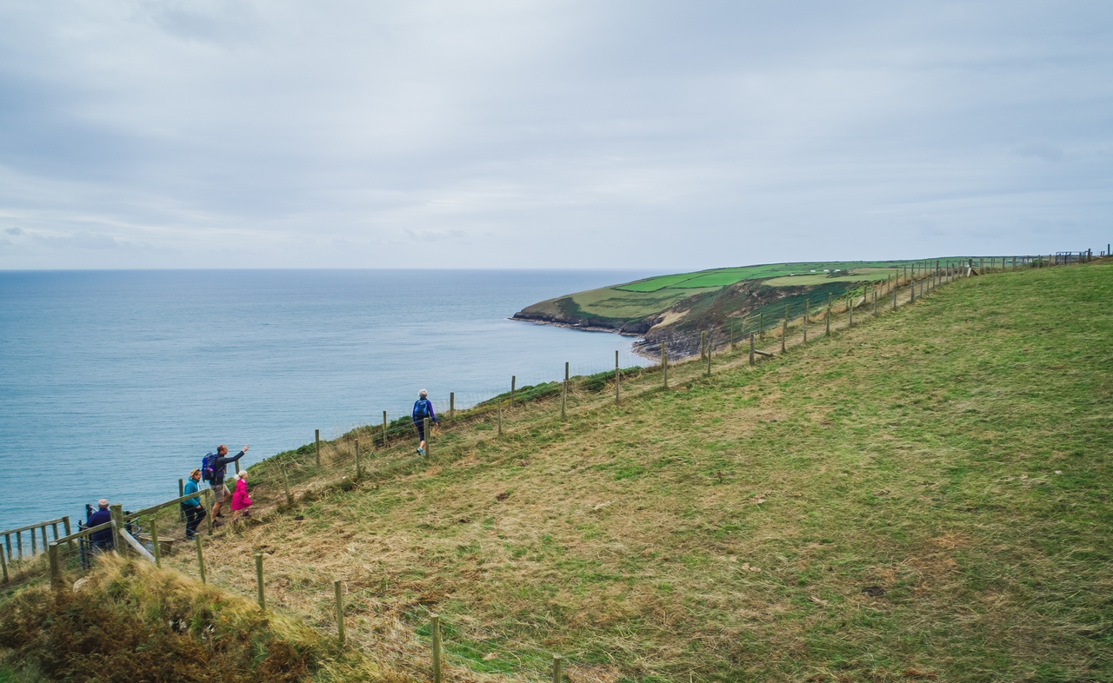
What does your website need to include?
Introduction?
The story?
Route map?
Distance information?
Location map?
Details of facilities?
Photographs?
Contact information?

Slide 23
When creating your website make sure:
It’s well written, high-quality content
If visitors are searching for information, the want to find the content that is well-researched. Search engines will give them the best results, which is hopefully your website.
You include keywords
Think about the words people would use to search for information about the Wales Coastal Path. This will help find your website from search engines.
Be aware of HTML
Well-written page titles and accurate alt image tags can give you a higher search engine ranking.

Slide 24
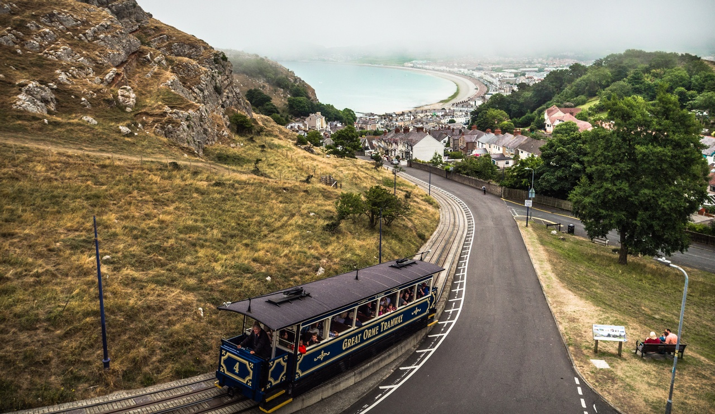
When creating your website make sure:
It’s interesting and relevant
Imagine you know nothing about the Wales Coast Path. When looking at your website, would you be interesting in reading it?
Include information such as:
Suggestions of walks and how long they will take
Wildlife sightings and/or conservation work
New services or facilities
Upcoming events, what to see/do when

Slide 25
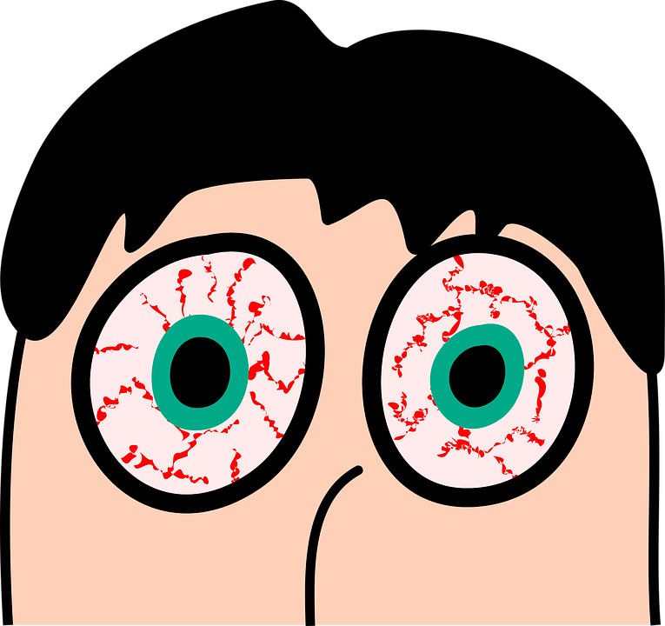
When writing your website make sure:
Your website won’t distress your reader’s retinas
Your website needs to look professional and shouldn’t be a shower of colour. Stick to 3 to 5 colours in your colour palette.
To keep it clean and simple
Less is more. A busy website can look cluttered and become outdated. A clean design won’t hurt your readers eyes and is timeless.
The website is branded and includes relevant logos
Who’s been involved? Acknowledges partners. Do any logos need to be included?

Slide 26
When writing your website make sure:
You use the right tone of voice
Writing voice and tone matter. Keep it simple, use straightforward language with no jargon, slang or acronyms. You are speaking directly to your audience through your website. Use positive language, adopt an active voice and write in the second person.
You link to a partner’s website
Links from trusted websites show you’re well-researched and makes visitors confident about the information on your page. Can you link to another group’s website?
Highlight the website on social media
Can you plan a social media campaign to advertise your website?

Slide 27
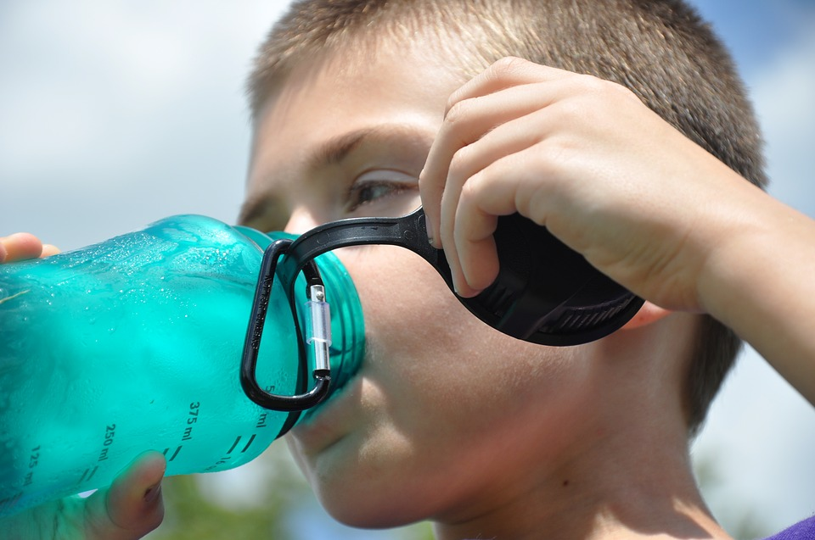
When writing your website make sure:
You make it easy for users to get in touch
How do users get in touch if they want to find out more?
Include a call to action
After looking at the website, what do you want the reader to do? Let the audience know: ‘Book today!’, ‘Refill here’ or ‘Visit soon!’

Slide 28
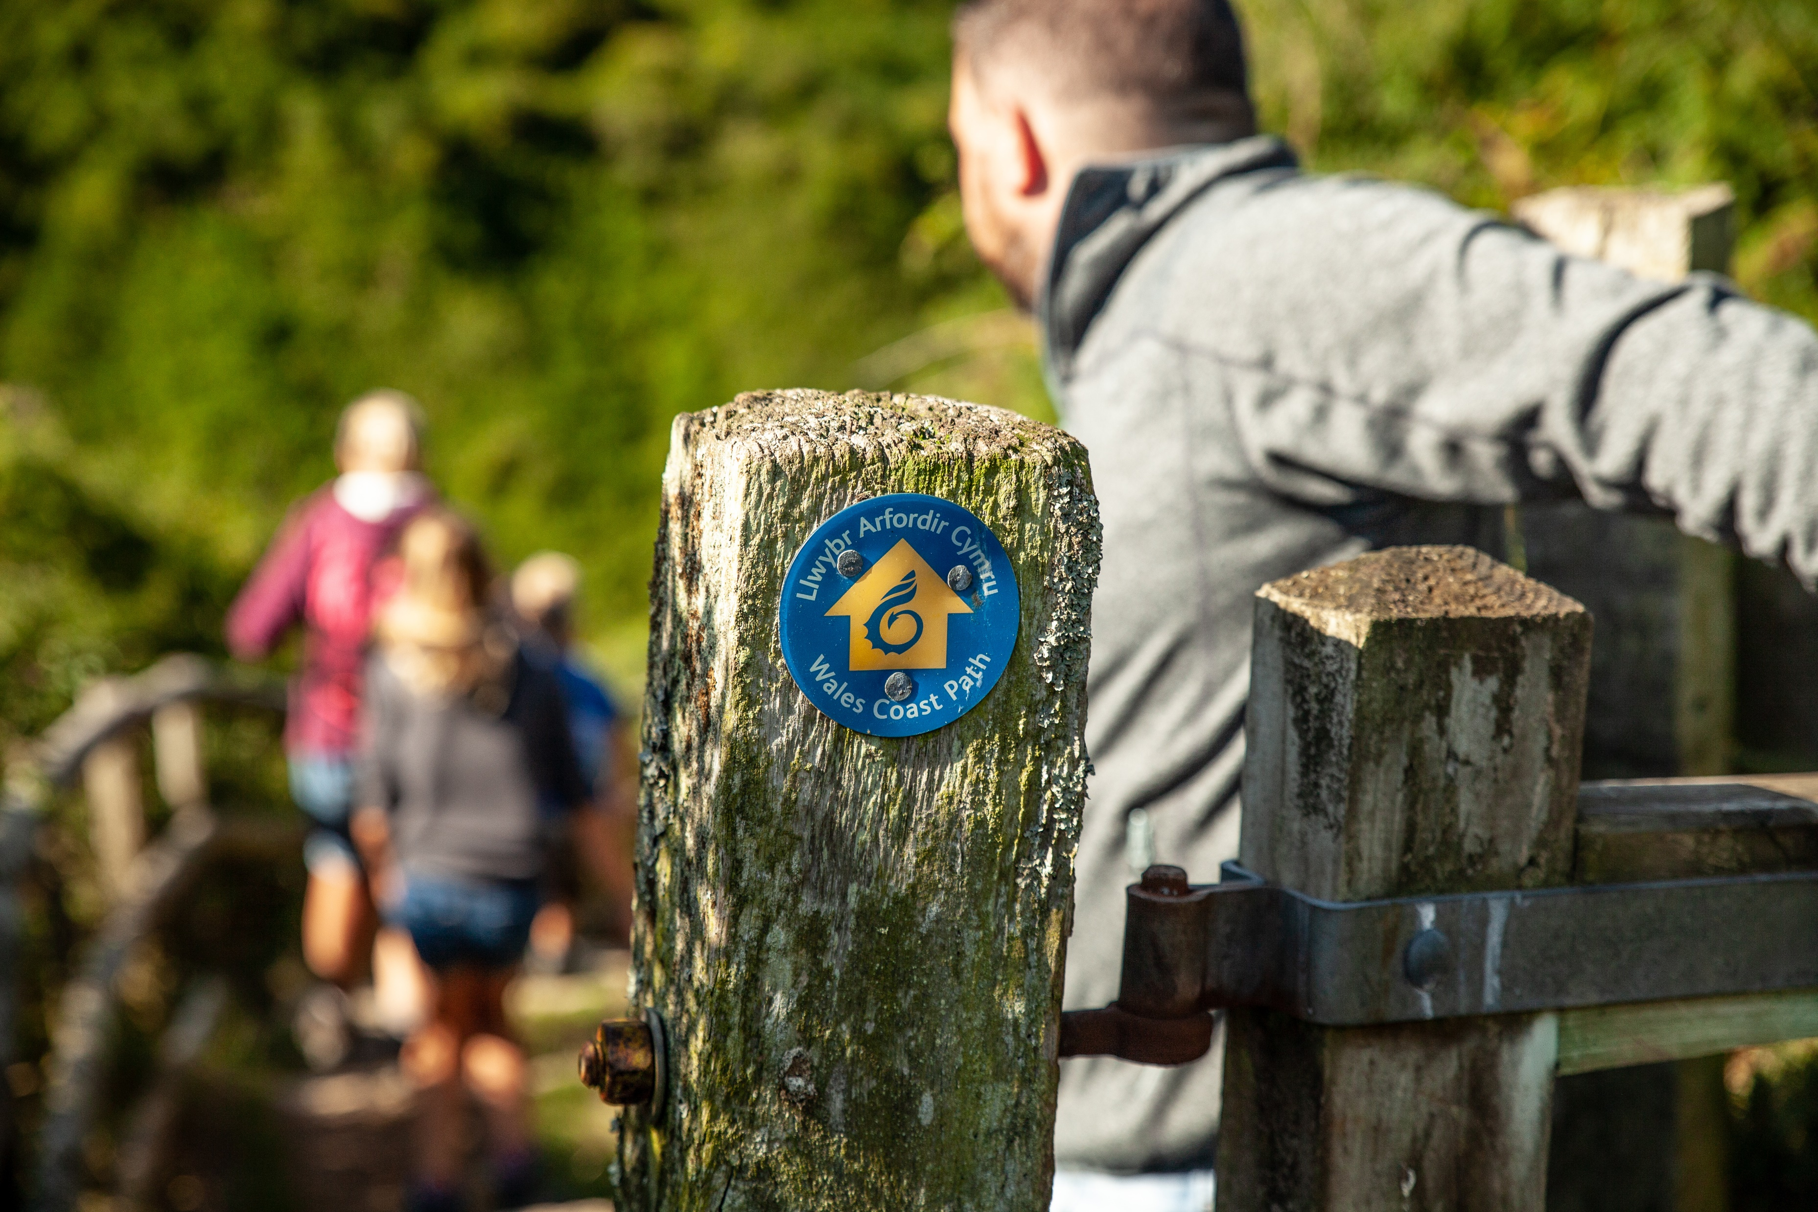
Choosing the right images
When choosing images for your promotional website consider:
Do the images help the user understand the point you are trying to make?
Do the images speak to your target audience? For example, if targeting families, a picture of a family out walking will be best.
Do the images create emotional appeal? Do they encourage the reader to visit the site and walk along the beach for themselves?
High-res images are a must!

Slide 29
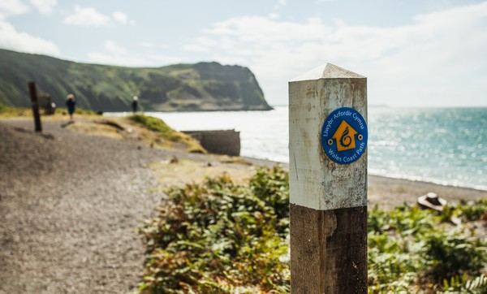
Identifying success
How will your know if your promotional website has made an impact and if you’ve met the ‘client’s’ brief?

Slide 30
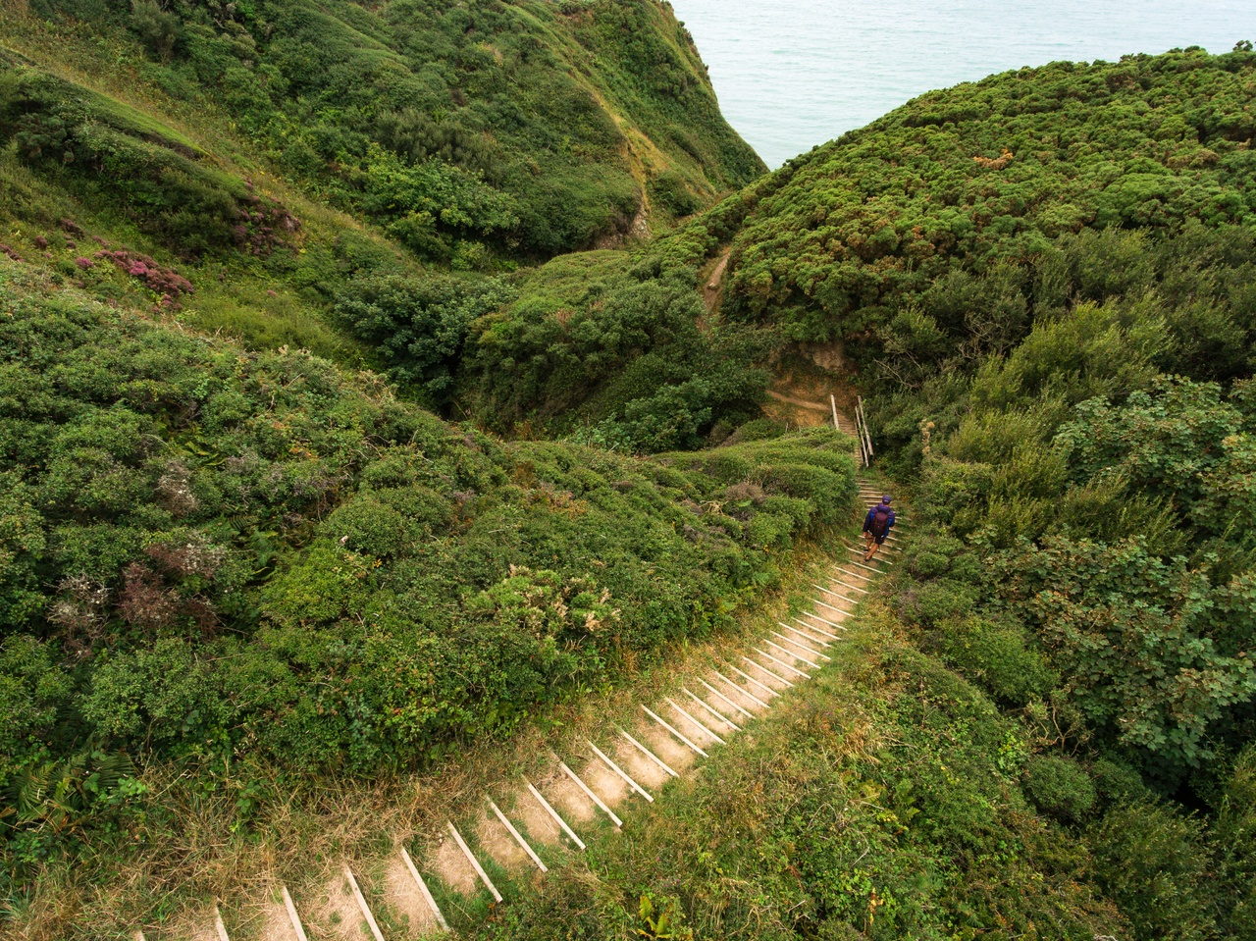
Lessons learnt
What were your group’s successes and weaknesses?
What steps can you take next time to ensure things go more smoothly?

