Slide 1
Campaigning for nature – Running a social media campaign

Slide 2
What is social media?
What to do you understand by the term ‘social media’?
What does social media do?
Why do people use social media?
How does social media differ from sending a letter?
What are the pros and cons of social media?
Can you name any popular social media tools and platforms?

Slide 3
Popular social media tools and platforms include:
• Blogs
• Facebook
• Twitter
• YouTube
• Vimeo
• Flickr
• Instagram
• TikTok

Slide 4
Your task
Imagine you are social media experts.
Your client would like your help to plan and prepare a social media campaign to raise awareness of an environmental issue or topic through your setting’s social media platforms.

Slide 5
Research your topic
Who or what is the campaign going to be about? Who or what does it affect?
What has, or is happening? What does it mean? What are the key facts?
When has, or is it taking place? Has it been going on for a long time? Is it a new phenomenon?
Where has, or is it taking place? Is it a local issue? National? International?
Why is it happening, or why did it happen? Why does the general public need to know about it?
How can people get involved in the campaign? Do you want people to take action? Learn something new? Change their habits?

Slide 6
Set SMART objectives for your social media campaign
Make sure your objectives are:
S – Specific
M – Measurable
A – Achievable
R – Relevant
T – Time bound

Slide 7
Set SMART objectives for your social media campaign
Make sure your objectives are:
S – Specific e.g. we want to run a campaign to raise awareness of the importance of saving water.
M – Measurable e.g. we want to increase our followers on Twitter by 5%.
A – Achievable e.g. there’s no point trying to plan a social media campaign to raise awareness of the importance of saving water across the world. It would be very hard to achieve. How about looking to raise awareness amongst the parents and guardians at your setting?

Slide 8
Set SMART objectives for your social media campaign
Make sure your objectives are:
R – Relevant e.g. the whole purpose is to run a social media campaign to raise awareness of an environmental issue or topic. If your plan is to raise awareness of a new restaurant that’s opening, then it’s not relevant.
T – Time bound e.g. is what you have planned achievable in the time you have available?

Slide 9
Are your key messages:
Concise? Are they easy to understand? Make your language concise, professional, and to the point.
Simple? Straightforward language; minimal jargon and acronyms.
Memorable? Easy to remember and repeat.
Positive? Present solutions to stimulate action instead of problems.

Slide 10
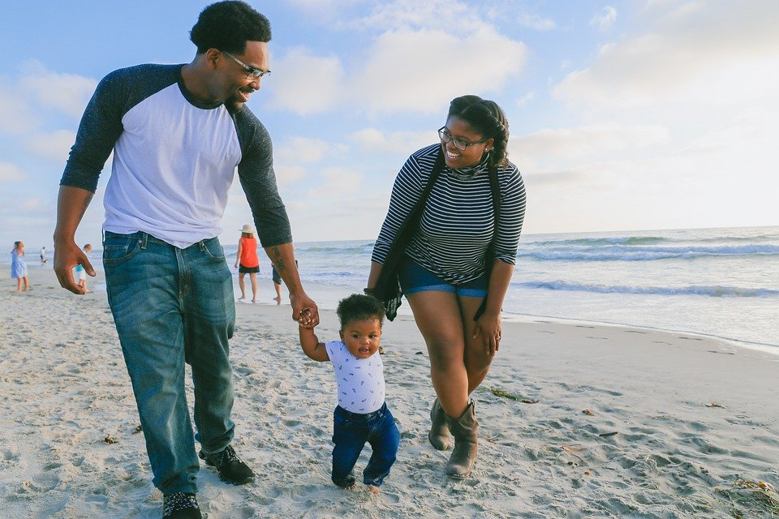
Who’s the audience?
Families?
Dog walkers?

Slide 11
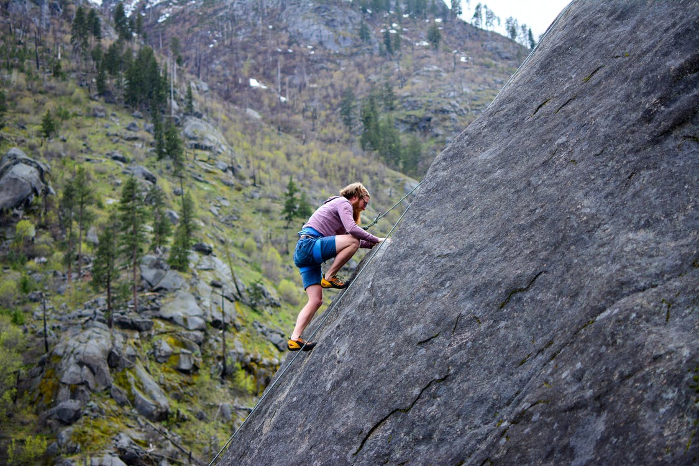
Risks/challenges
What could go wrong with your social media campaign?
2. What is the likelihood and impact of something going wrong?
3. What can you do to minimise the risk?

Slide 12
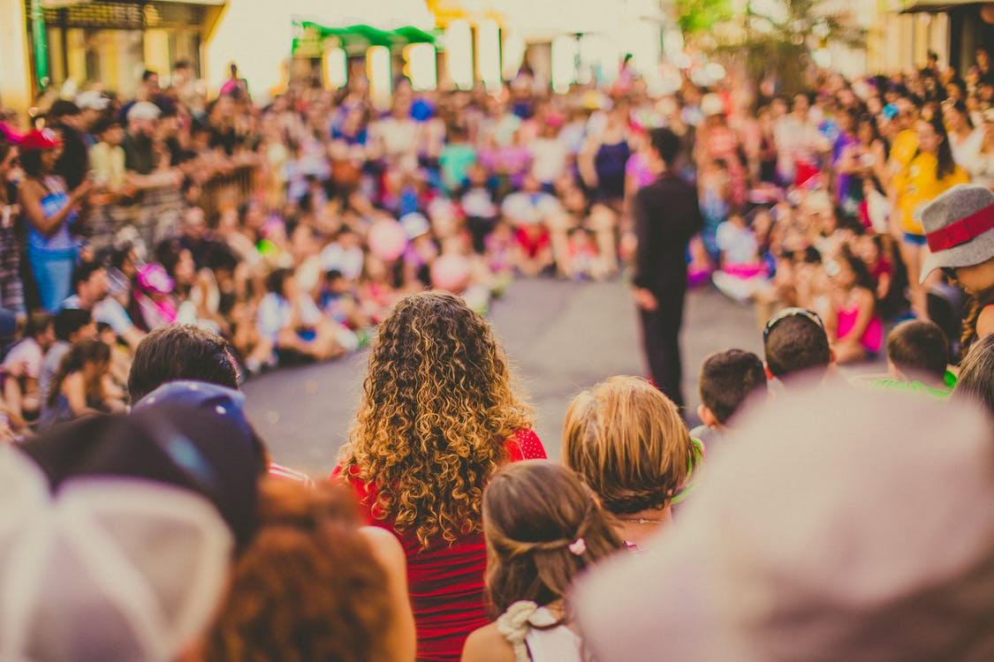
Social media platform
Which social media platform will you use to share your messages?
Which social media platform is best to reach your target audience?
Which social media platform will you use to share your messages?
Which social media platform is best to reach your target audience?

Slide 13
A successful campaign will:
Catch attention
Be visually attractive
Offer something new or a new idea/angle on the subject matter
Be exciting or amusing
Achieve the objectives set at the start
How will you ensure that your campaign meets these criterion?

Slide 14
Tone – How will the campaign make the audience feel?
• Dramatic? Moves the audience emotionally.
• Informative? Factual, clear and concise.
• Conversational? Casual and authentic, as if speaking to someone you already know.
• Inspirational? Uses inspiration and motivational language to drive action.
Urgent? Persuasive and urges the audience to act.
Funny? Makes the audience laugh or smile.
Cute/feel good factor? Something that makes the audience go “awww!”.
Entertaining? Aims to inform and entertain.

Slide 15
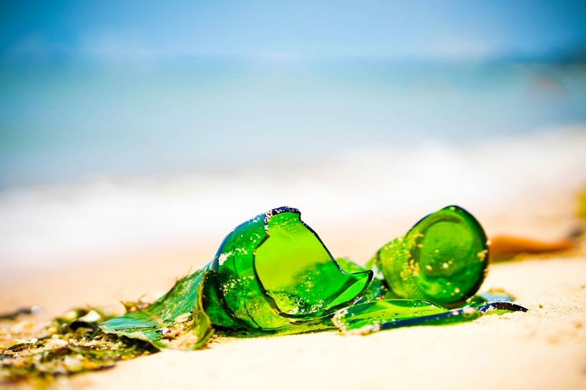
Drafting posts - visual styles and techniques
You could include:
Photos, film and graphics
A visual representation of scientific information or data
Visual quotes or interviews with people or experts
Video of a celebrity or an influencer talking about the key message
An animation

Slide 16
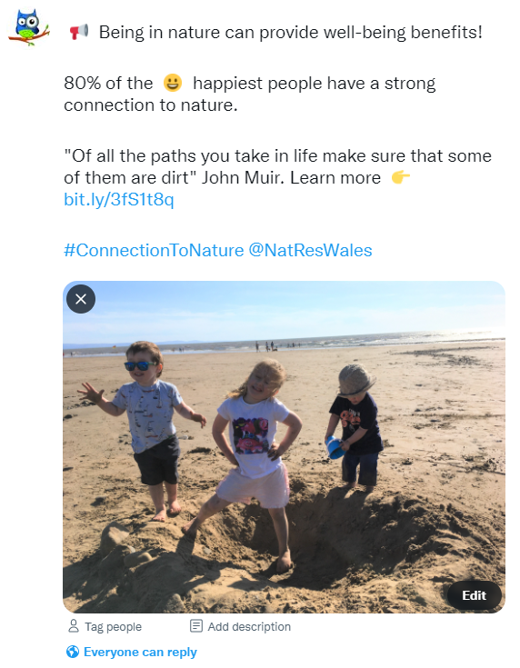
Drafting posts - Writing a script for the social media posts
Start your post with a headline.
Does your post need a second headline to explain better what the content is about?
Tagging an individual, organisation or any entity with a social profile that supports your message will allow you to engage with them.
A quote to help your post stand out.

Slide 17
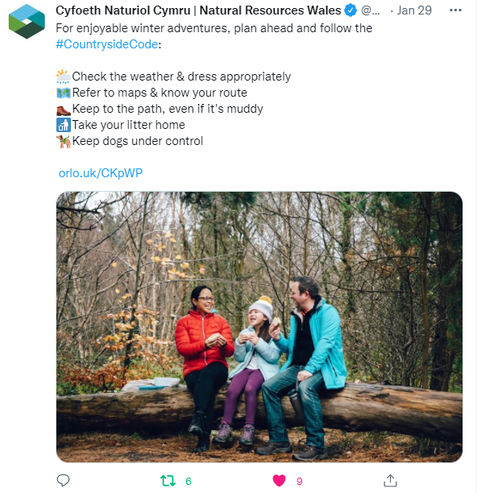
Drafting posts - Writing a script for the social media posts
Hashtags? A hashtag is a clickable
keyword or topic, such as #sanddunes.
Keep it snappy - Make it too short, and your posts risk getting overlooked. Too long and they might reach the platform’s character limit and lose the audience’s interest.
Line breaks can help a post stand out by making it more visually obvious in the stream.

Slide 18
Drafting posts - Writing a script for the social media posts
Language – will you post bilingually? Separate language posts?
Thorough checks - ensure that your campaign is going to deliver your key messages. Check that your posts:
are appropriate
below the character limit
have a suitable image, style and tone
don’t have any spelling or grammatical mistakes

Slide 19
Scheduling your posts
What time period will your campaign run for? A day? A week? A month?
Will it run in the lead up to an event or during a specific time of year?
When is the best time of day to reach your audience?
Do you need to write a posting schedule?
Will you schedule your posts to be sent out by your social media platform?

Slide 20
During the campaign
When will you check your campaign’s progress?
Who will check your campaign’s progress?
Which posts performed best?
Is there anything you need to change?

Slide 21
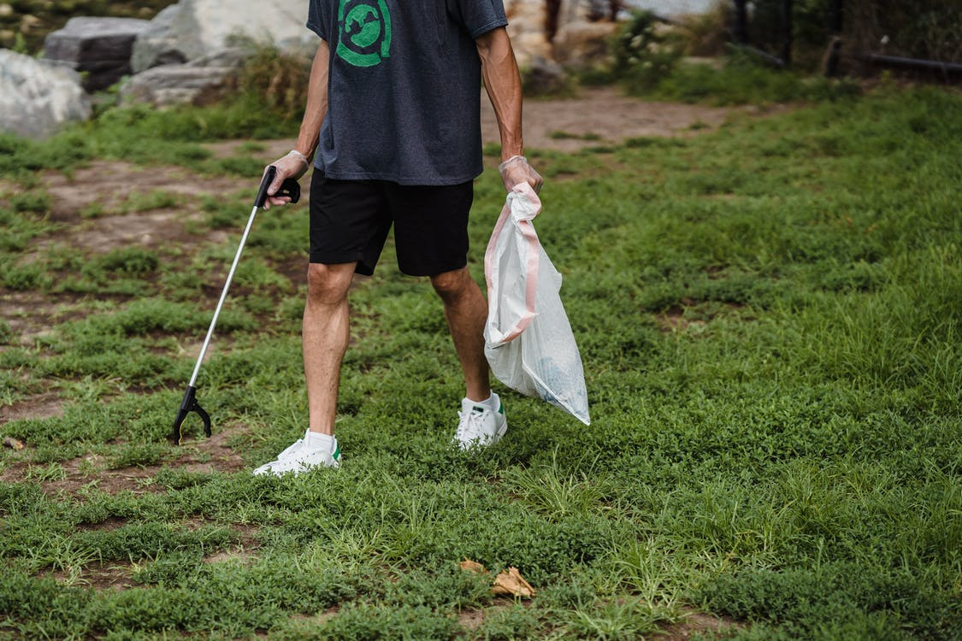
Identifying success
How will you know if your campaign has been successful?
How many likes, shares and comments did you receive?
Increased use of the hashtag?
Increased website hits?
How many users watched a video that was shared?
Have people taken practical action?

Slide 22
Lessons learnt?
What were your campaign’s strengths?
What were your campaign’s weaknesses?
What would you do differently next time?

