Slide 1
An example of a high risk felling operation
Bont Evans Tree Works and
Stabilisation (BETWS) Project

Slide 2
Purpose of this Presentation
This presentation gives an overview of the aims and outputs of the Bont Evans Tree Works and Stabilisation (BETWS) Project, an example of a high risk felling operation. It outlines all of the different factors that had to be taken into consideration during the delivery of the project.
Aimed at Forestry and Countryside Management students, the presentation may also be of interest to the general public who want to know more about the project.

Slide 3
Contents
History of the site
Introduction to the BETWS Project
Why was felling necessary?
Scale of the felling
Factors may have made the trees unstable
PESTLE Analysis
Tree felling & Skyline extraction system
Traffic management
Stabilising the bank
Access
Drainage
Timber volume
Invasive species
European Protected Species (EPS)
Communication
Looking back on the project

Slide 4
History of the site
Following the First World War there was a national need to rebuild and maintain a strategic timber reserve to meet Britain’s timber needs for the foreseeable future.
This led to the formation of the Forestry Commission in 1919.
As a result of this drive to plant trees the Bont Evans block was planted just before the Second World War.
Question – why do you think the land above Ceinws was chosen for planting?

Slide 5
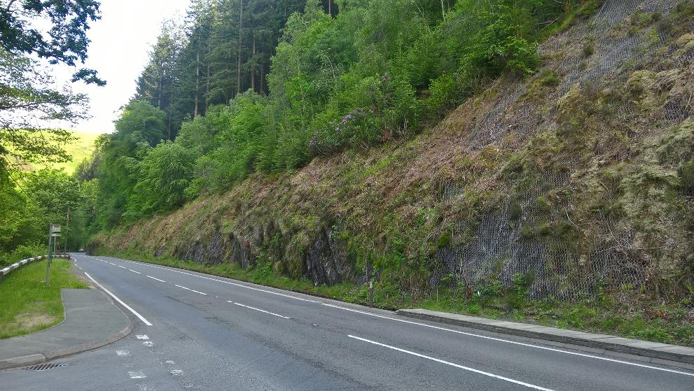
History of the site
Trying to balance the increasing need to produce home grown food and finding land for tree planting was difficult.
With good agricultural land no longer available in any great quantity, planting gradually moved out to the uplands and marginal land which was unsuitable for crops.
Planted just before the Second World War, growing on a very steep hillside at a 60 degree angle in some places, the Bont Evans block was a classic example of tree planting on marginal land.
The species that were planted were mainly Douglas Fir and Western Hemlock, with Sitka Spruce, Norway Spruce, Cryptomeria and a small amount of mixed deciduous species.

Slide 6
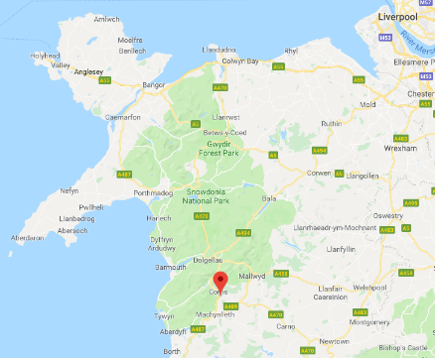
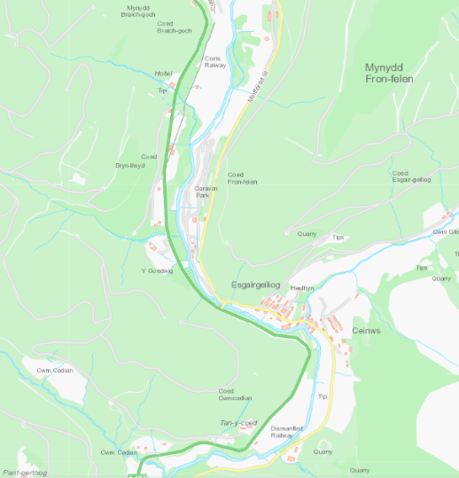
Introduction to the BETWS Project
The BETWS project was set up to:
Fell large coniferous trees close to Evans Bridge, near Ceinws in Powys
Due to the size of the trees and the difficult terrain, unlike some of NRW’s other tree felling operations which are reasonably straightforward, this project was an example of a high risk felling operation.
Dawnus were contracted by NRW in November 2017 and the high risk fellings works were completed in March 2019.
A487

Slide 7
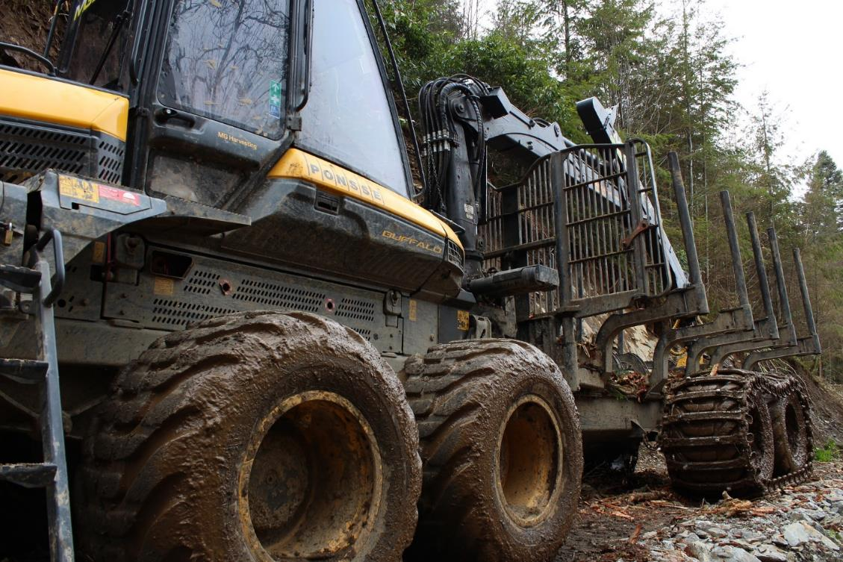
Question - why do you think felling was necessary?
The trees had become unstable.
Because of their instability, the risk of trees and debris falling onto the road was increasing each year - this could have led to unplanned road closures and potentially a major accident.
There has already been two incidents in the 15 years preceding the work which had caused disruption.

Slide 8
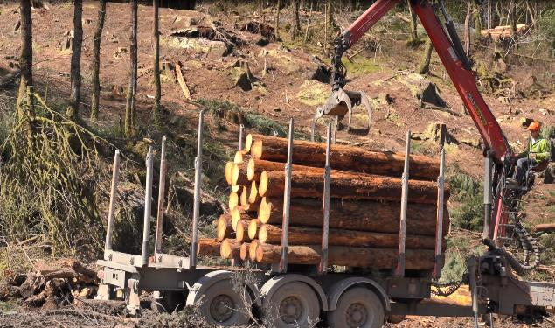
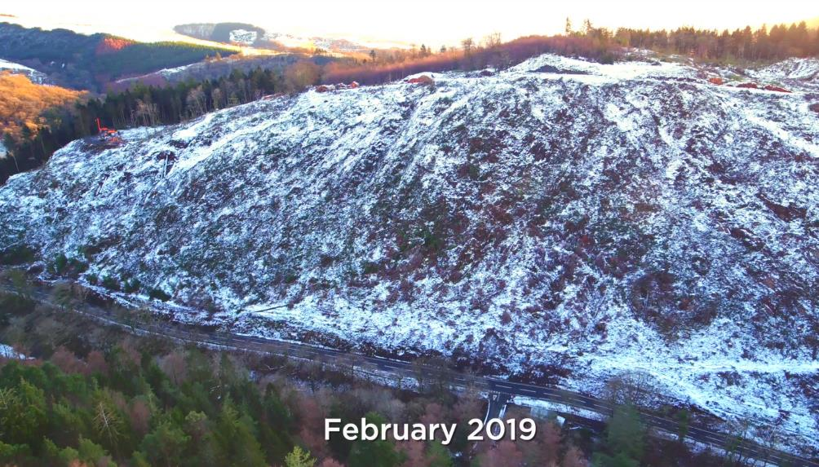
Scale of the felling
Area: 22 hectares (about 30 football pitches) clearfelled.
Total volume of timber felled: 15,000m³ which is around 12,000 tonnes
Timber income - over £500,000 which partially offset the cost of project delivery. The felled timber was sold to supply the construction, agricultural and woodfuel industries. However this project was not about commerciality but more importantly the removal of a risk (unstable trees) above a major trunk road, the A487.

Slide 9
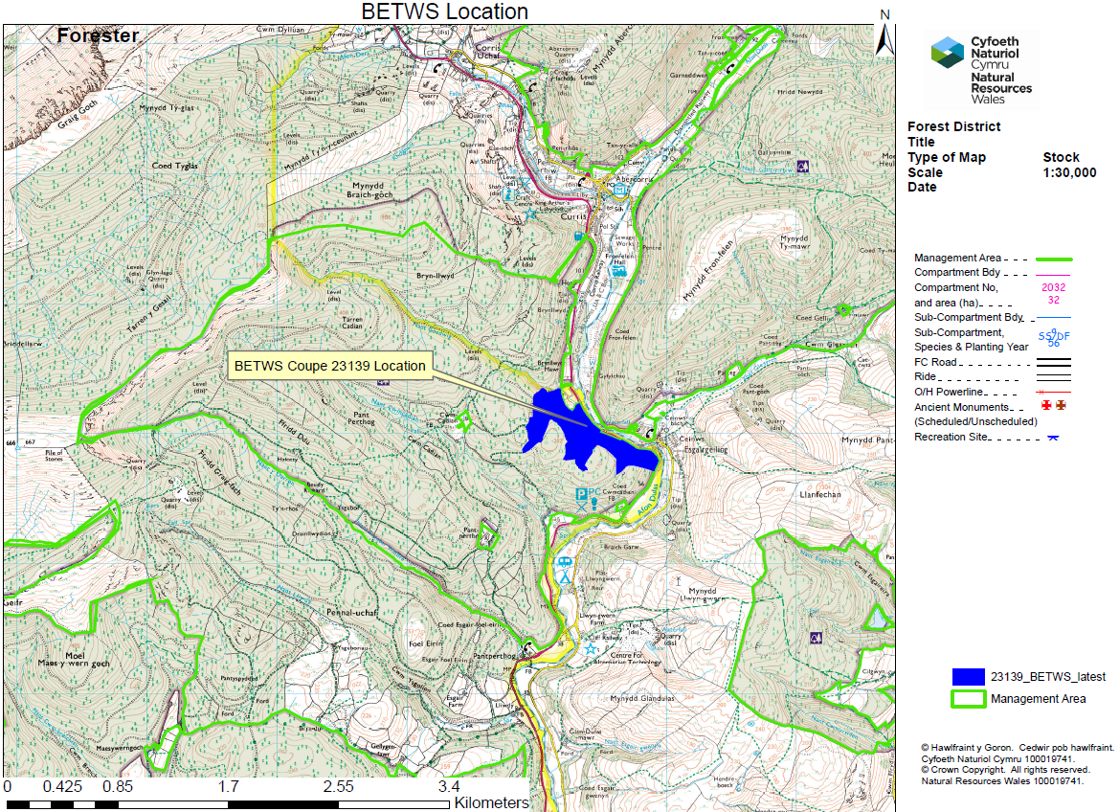
BETWS coupe location

Slide 10
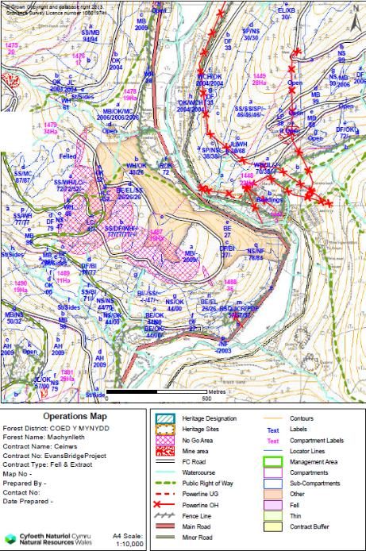
Coupe maps

Slide 11
Discuss - What factors may have made the trees unstable?
Age - As trees age, root decay becomes more common. Under certain soil conditions, there is the possibility that the tree’s roots may begin to rot, reducing the tree’s grip in the soil (reducing its stability).
Condition – A tree which is suffering from the effects of pests and diseases is likely to be under stress and its’ roots may have begun to weaken and decay making it less resilient to the effects of high winds.

Slide 12
Discuss - What factors may have made the trees unstable?
Height - The taller the tree, the more susceptible they are to the phenomenon known as windthrow which is when the force of the wind uproots or blows trees over. Tall trees receive less shelter from the force of the wind at their upper reaches. The tree trunk acts as a lever with the fulcrum point being the surface of the ground that the tree is growing out of. The taller the tree the longer the ‘handle’, giving the wind a longer lever, making the wind’s force more effective at delivering force down to the ground, disrupting the tree’s stabilising system (it’s roots in the soil). Some of the trees felled by the BETWS project were over 43m tall.
Weight - Some of the trees felled weighed up to 12 tonnes! This massive weight coupled with the height and age of some of trees meant a massive pressure was being exerted on the tree roots, making them potentially less stable.
Exposure to high winds - Tree failure is more likely with increasing wind strength. Strong winds cause trees to sway, pulling and stretching their roots. This movement disrupts root-soil contact and can lead to a decrease in water absorption. Trees growing in dense forest stands become very prone to windthrow when surrounding trees are removed, exposing the remaining ones to the full force of the wind. A crucial factor in determining a tree’s resistance to breakage or uprooting is the air drag or sail effect of the canopy. As conifers have foliage throughout the year conifers are more susceptible than broad-leaved trees to damage by wind.

Slide 13
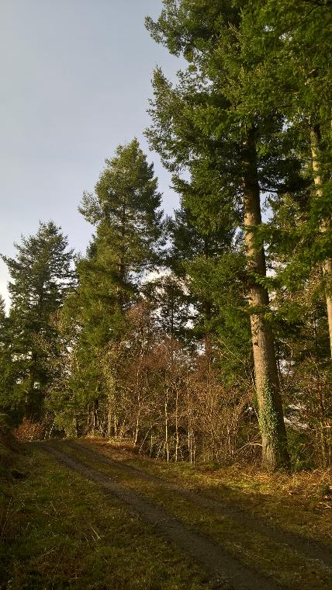
Discuss - What factors may have made the trees unstable?
Steepness of the site - The site was very steep. In the event of trees blowing over at BETWS, the weight and size of the trees present coupled with the steepness of the site meant that they would pick up speed whilst travelling down the hill towards the road. Two incidences were recorded between 2002-2017 of trees came down the slope and causing disruption.
Ground conditions - Ground conditions also made the trees unstable. The bedrock at the site is located very close to the ground’s surface which meant that the trees were planted in a very thin, poor quality layer of soil. Resultantly, root plates were unable to penetrate the impervious layer of rock, becoming shallow and widespread rather than a well-anchored root ball of significant depth. As a result, the trees had less physical support from their root systems and were consequently vulnerable to the effects of wind.

Slide 14
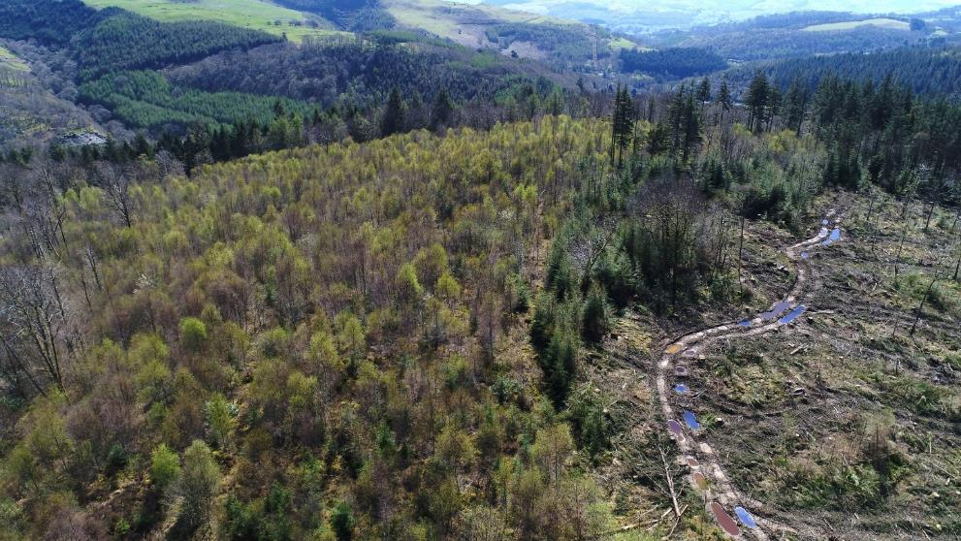
Project considerations
Task - Imagine you are the Project Manager.
Complete a PESTLE analysis to identify issues which would have to be taken into consideration when planning the felling project?
P – Political
E – Economic
S – Social
T – Technological
L – Legal
E - Environmental

Slide 15
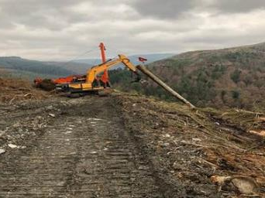
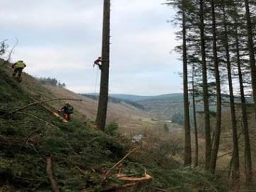
Project Delivery

Slide 16
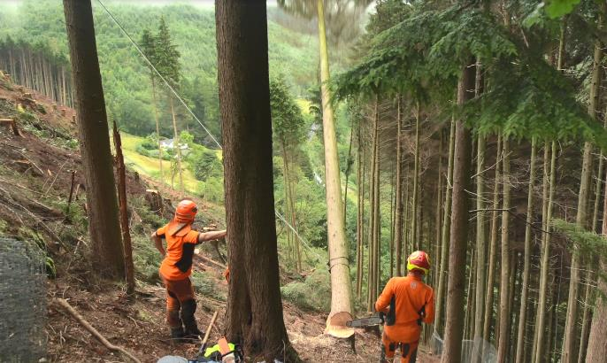
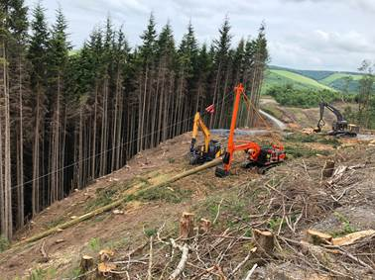
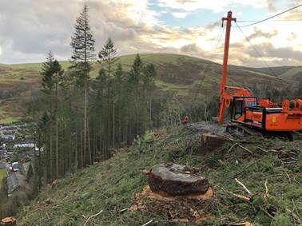
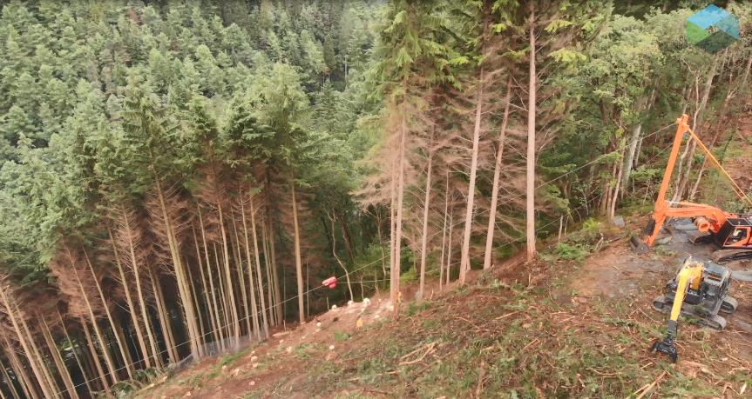
Tree felling & Skyline extraction system
A skyline uses a stationary winch and a series of cables and pulleys to move fully suspended logs held firmly on a locking carriage over obstacles to the roadside for processing and stacking.
The trees were felled manually. The skyline used for the BETWS Project was an upgraded, bespoke modified 26 tonne excavator unit that was anchored to a working platform at the top of an embankment.

Slide 17
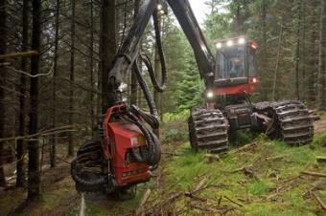
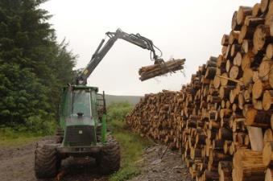
Consider - why was manual felling and Skyline extraction chosen over a harvester and forwarder for the felling and extraction of the timber?
Harvester - A harvester is a machine used to mechanically fell trees.
Forwarder - A machine used in the harvesting process for hauling a log completely off the ground from the stump to a road side landing, ready for despatch.
A harvester working
A forwarder piling a log stock

Slide 18
A skyline system was used as opposed to a harvester & forwarder because:
The trees above the A487 were very heavy and had been growing on very steep slopes which meant that they had to manually felled by chainsaw and cut into smaller sections before being extracted and stacked.
Felling was being undertaken on steep ground where it was unsafe and un-efficient to use standard harvester/forwarder methods to extract the timber as there was a risk that the machines would topple over.
Use of a skyline system meant that the amount of land disturbance and the environmental impact of the project was reduced.
Had a harvester/forwarder extraction been used there would have been a cost to put in new tracks to accommodate the machines.

Slide 19
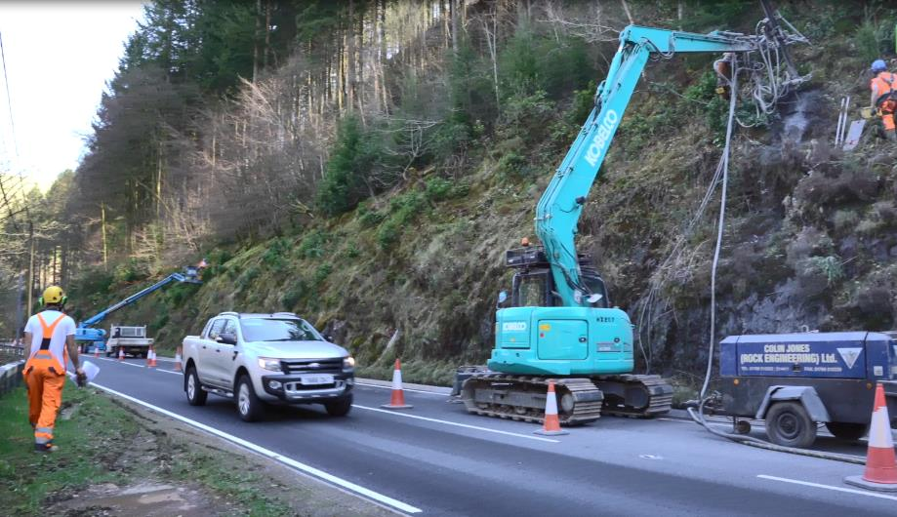
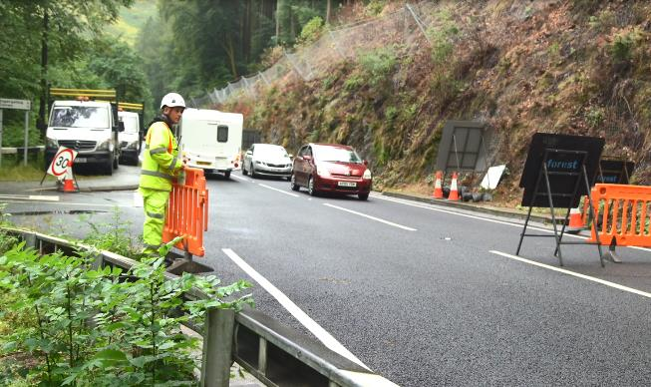
Traffic management
The location of the A487 trunk road immediately below the trees meant traffic management was needed for some of the work.
Removing the trees from the steepest parts of the slope was high risk because a tree could have fallen on the road while it was being felled.
To keep people safe on the road below, traffic on both sides was stopped for up to ten minutes each time a tree was felled or removed.
Traffic management was in place for nine months however no traffic management was undertaken during peak hours, weekends and bank holidays.

Slide 20
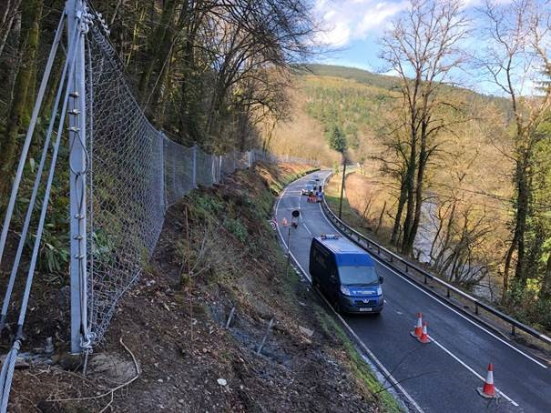
Stabilising the bank
A geotechnical engineering sub-contractor was appointed to help prepare the site for felling.
This involved assessing the condition of the slope face and the supply and install of a 900 metre rock catch fence costing £400,000 to stop rocks and debris from falling onto the road.
During the duration of the harvesting operation the engineers completed monthly inspections, re-tensioning the fence after treefall and instructing the clearance of any loose stones that had become dislodged to reduce the risk of stones falling on road users below.
The fence remained in situ for 2 years post completion of the felling to enable the area to re-establish.

Slide 21
Stabilising the bank
On the embankment itself, the depth of the soil above the bedrock was very shallow. Resultantly the likelihood of the slope slipping as a result of disturbance by the felling work was minimal.
During the duration of the harvesting operation the geotechnical engineers inspected the site at monthly intervals for evidence of slope instability.
Soil depth
Figure 1 - Profile of an average slope and the possible effects of disturbance
Bedrock
Slope
Soil depth
Bedrock
Slope
Figure 2 - Profile of the Bont Evans slope and the possible effects of disturbance

Slide 22
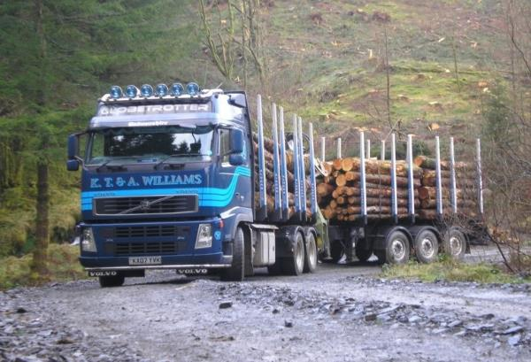
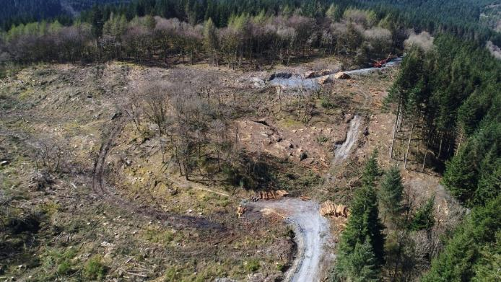
Access
Consider – why is ensuring suitable access essential to any harvesting operation? What might the consequences of poor access be?
Forest roads provide the most important means of accessing forests for forest management and timber harvesting purposes. Without suitable access, it would not be possible for many woodlands to be economically managed.
Forest roads usually have gravel surfaces and are designed for year-round use. Poor design or construction can result in: inadequate access being created, environmental damage (soil erosion caused by surface run off) and high repair and maintenance costs.
Well planned and properly constructed tracks will have a minimal impact on the environment but will still need to be maintained in order to sustain the productivity of the woodland and maximise the life span of the investment.

Slide 23
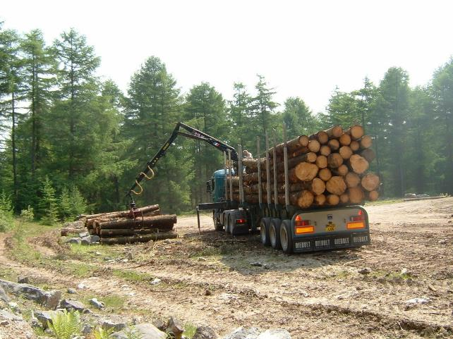
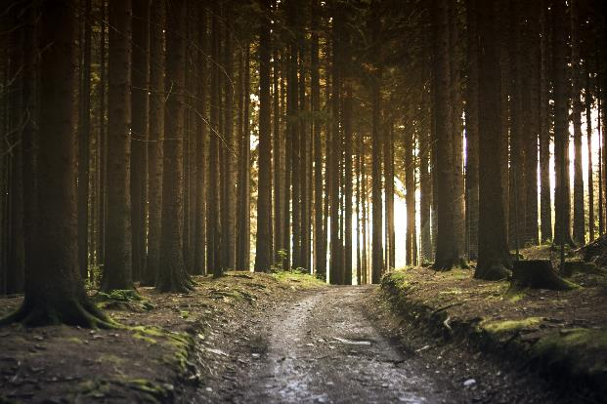
Access for the BETWS Project
As part of the BETWS Project, temporary access tracks and new turning spaces were installed to provide access for the collection and transport of the felled timber to the market.
3km of existing forest roads were upgraded with 6,500 tonnes of recycled slate waste and 3,000 tonnes of dug rock from a local quarry to ensure access tracks were up to forestry standards.
The work included: scraping and widening the existing road in places, introducing an improved surface layer and extending turnaround areas.

Slide 24
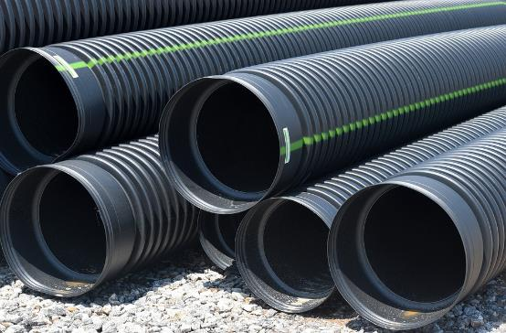
Drainage
The pipes and tunnels found underneath roads and
railway tracks are known as culverts.
Question – what do you think their purpose is
within a forest context?
Typically found in a flow of water, culverts direct water under forest roads as access tracks cannot be allowed to obstruct the water flow.
Made of materials such as concrete, steel or aluminium a culvert often acts as a bridge for vehicles to pass over.
The purpose of constructing culverts is to prevent flooding, minimise erosion of roads forest and soil and provide pathways for water run-off.

Slide 25
Improving drainage as part of the BETWS Project - culverts
In a bid to improve roadside drainage, 14 road culverts were replaced, enabling forestry traffic to drive over waterways whilst providing pathways for water run-off, reducing the risk of soil erosion. The size of culvert required was calculated by assessing rainfall data and LiDAR data of the drainage catchment area.
LiDAR (Light Detection and Ranging) technology is used from the air to beam rapid pulses of laser light at a surface. A sensor on the LiDAR instrument measures the amount of time it takes for each pulse to bounce back. Light moves at a constant and known speed so the LiDAR instrument can calculate the distance between itself and the target with high accuracy. By repeating this in quick succession the instrument builds up a complex 'map' of the surface it is measuring. (www.lidar-uk.com)
The majority of culverts were replaced with corrugated plastic pipes, 9-12 metres in length and 300mm to 450mm (occasionally 600mm where necessary) in width.

Slide 26
Improving drainage as part of the BETWS Project – silt traps
Silt traps were installed to prevent silty run off from the site. A silt trap is a device which works essentially like a filter, where water which contains silt, soil or sediment as a result of construction activity or water run is contained.
Whilst the water is in the trap, the sediment can settle to the bottom of the trap until it can be removed.
Pictured – a sedimat silt trap.
A hessian sandbag weir has been established downstream of the sedimat pictured. The weir slows down the flow in the stream, allowing the sedimat to filter out the silt.

Slide 27
Improving drainage as part of the BETWS Project – silt traps
A timber lorry had just driven past the silt trap shown when pictures 1 and 2 were taken, creating quite a bit of silty run off. The sedimat and weir removed the slit as can be seen in photo 2.
Photo 1 Photo 2

Slide 28
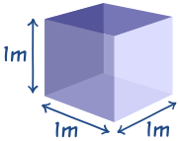
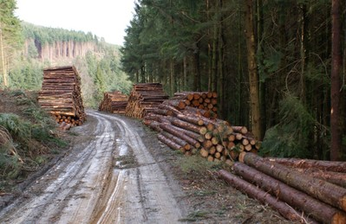
Timber volume
Timber is sold by volume. The volume measurement used in the industry is cubic metres (m³).
A cubic metre (m³) is 100cm x 100cm x 100cm = A volume that is made by a cube that is 1 metre on each side.
On average, a volume of 1,000m³ or 700 tonnes of timber was stacked at roadside for collection at any given time during the duration of the project.

Slide 29
Invasive species
Rhododendron ponticum is native to countries in the Mediterranean, Asia and China. It is not native to Britain, but was first introduced in the late 18th Century. It became especially popular on country estates in Victorian times, providing ornamental value, as well as cover for game birds.
Rhododendron
The plant is responsible for the destruction of many native habitats.
Where conditions are suitable, Rhododendron will out compete most native plants. Growing to many times the height of a person, allowing very little light to penetrate through its thick leaf canopy, this effectively eliminates other competing native plant species which are unable to grow due to insufficient light. This in turn leads to the consequent loss of the associated native animals.

Slide 30
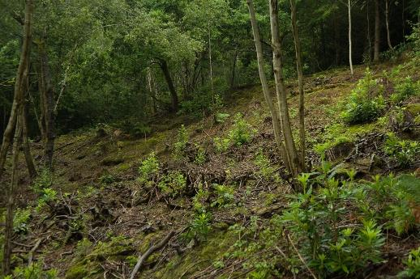
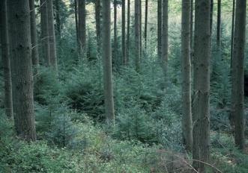
Managing invasive species as part of the BETWS Project
The Bont Evans block is a PAWS site – Plantations on Ancient Woodland Sites. Sites such as these were planted with non-native species, mostly during the 20th century to provide a strategic timber reserve.
Present on the steep embankment above the catchfence, Rhododendron was cut and sprayed on site (an area of probably 400m x 50m) by an experienced team working from harnesses.
Coniferous seedlings most commonly Western Hemlock which in a PAWS site are considered invasive, were treated to prevent regrowth.
Following the project the site was allowed to regenerate with some replanting of small native broadleaf species e.g. hazel and rowan to stabilise the soil.

Slide 31
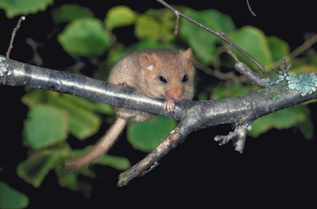
European Protected Species (EPS)
Some species of plants and animals have declined throughout Europe to such an extent that they are now offered special protection in law. The Conservation of Habitats and Species Regulations 2017 transposed into UK law the EC Habitats Directive of 1992, which listed European Protected Species (EPS).
The dormouse (muscardinus avellanarius) is an EPS.
Under the Habitats Regulations, it is an offence to:
Deliberately capture, injure or kill any wild animal of an EPS
Deliberately disturb wild animals of any such species
Deliberately take or destroy the eggs of such an animal, or
Damage or destroy a breeding site or resting place of such an animal

Slide 32
Protecting wildlife during harvesting operations
NRW’s Conservation and Heritage Officer made regular checks to ensure the felling didn’t damage any nests or important areas for wildlife.
The grass on site was cut short prior to felling works commencing and possible nesting habitat removed to deter dormouse from nesting whilst operations were in progress.
Surveys for other EPS were conducted along with regular raptor surveys - old nests were removed to prevent them from returning to the site.
Native trees and shrubs were retained where possible along with standing deadwood and loose stumps, which are vital for insects and fungi.

Slide 33
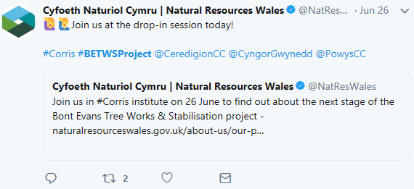
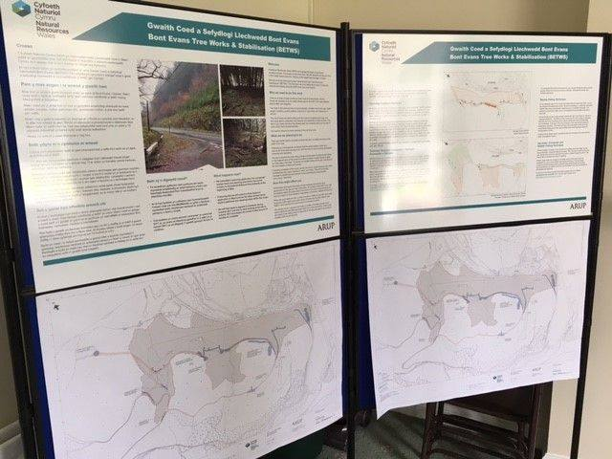
Communication
Good communication was essential during the planning and delivery of the project to keep locals and road-users up-to-date with project progress.
#BETWSproject #Corris @NatResWales

Slide 34
Looking back on the project
This video looks back on the work that was completed as part of the project.
2.39 minutes

Slide 35
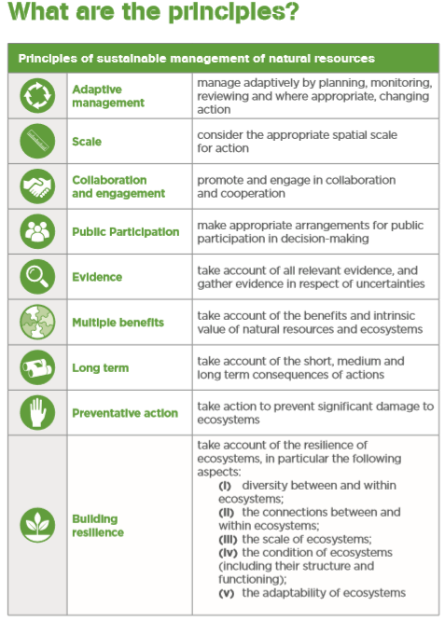
Post-felling plan
Return the site to a PAWS, functioning native woodland ecosystem and manage the woodland using the principles of Sustainable Management of our Natural Resources (SMNR).

Slide 36
Contact us! education@naturalresourceswales.gov.uk www.naturalresourceswales.gov.uk/learning

